Slide 1

BIOMASS
PELLETS
&
Power

Slide 2
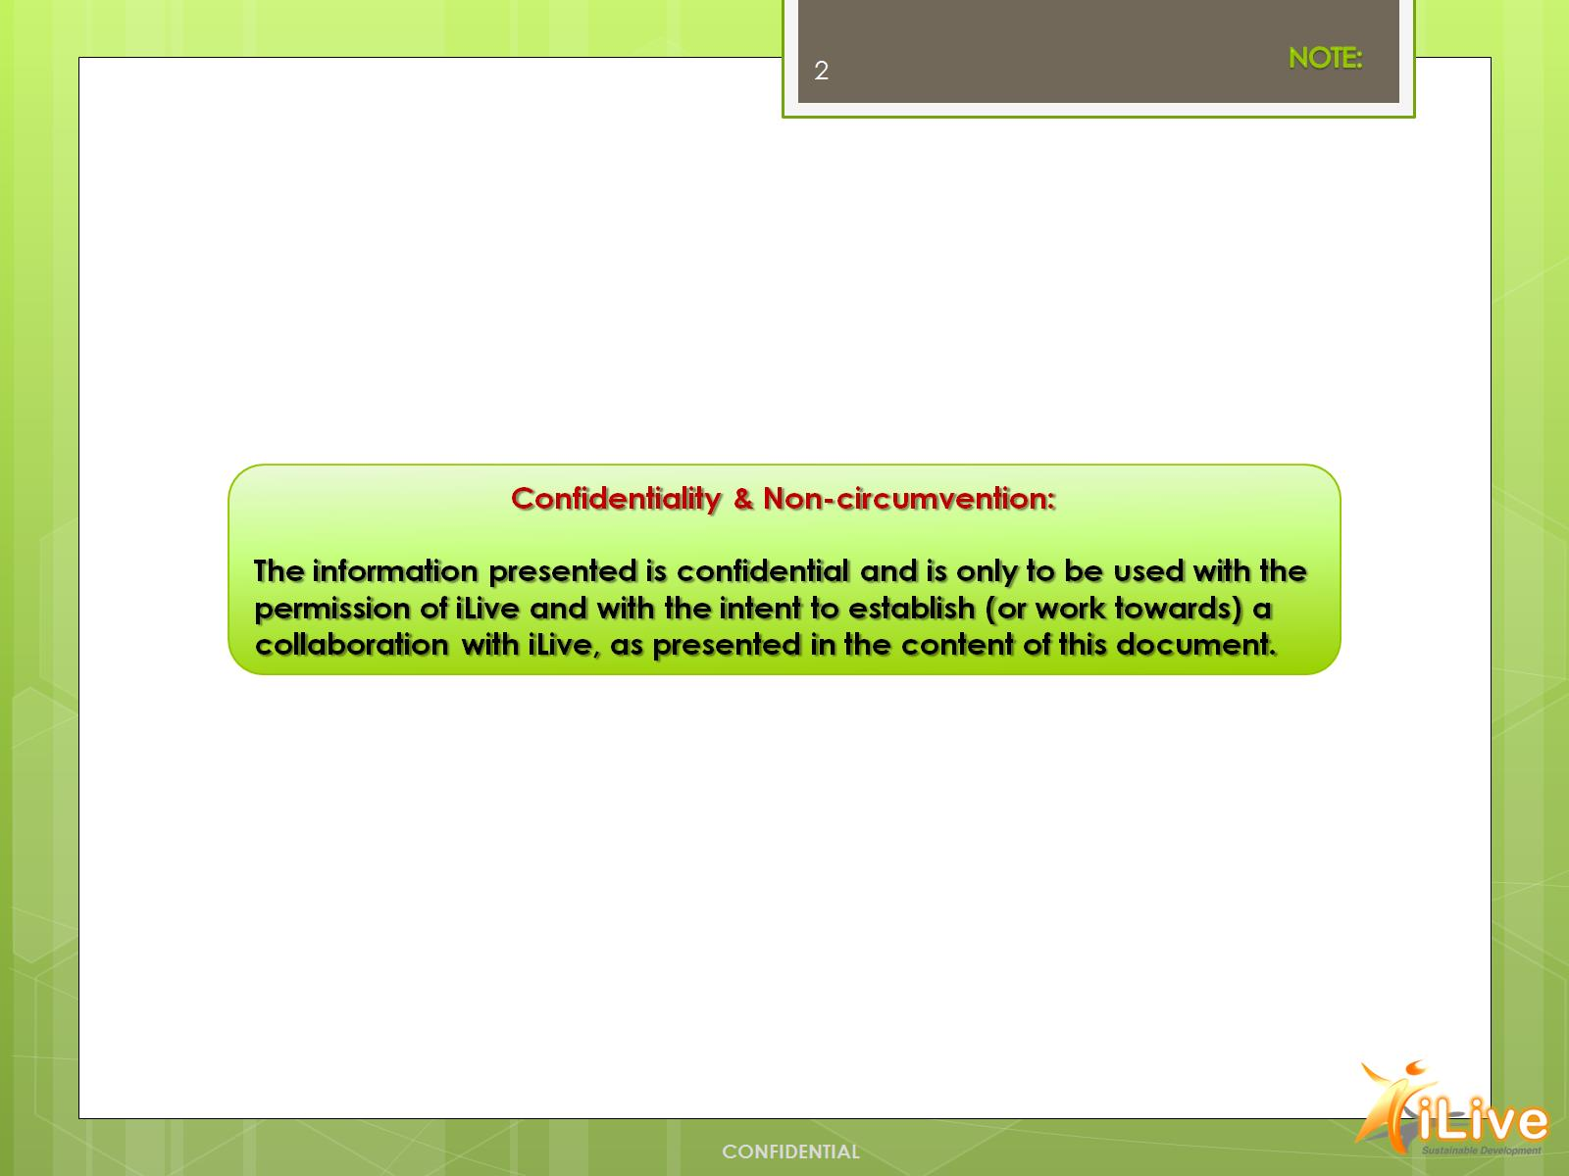

Slide 3
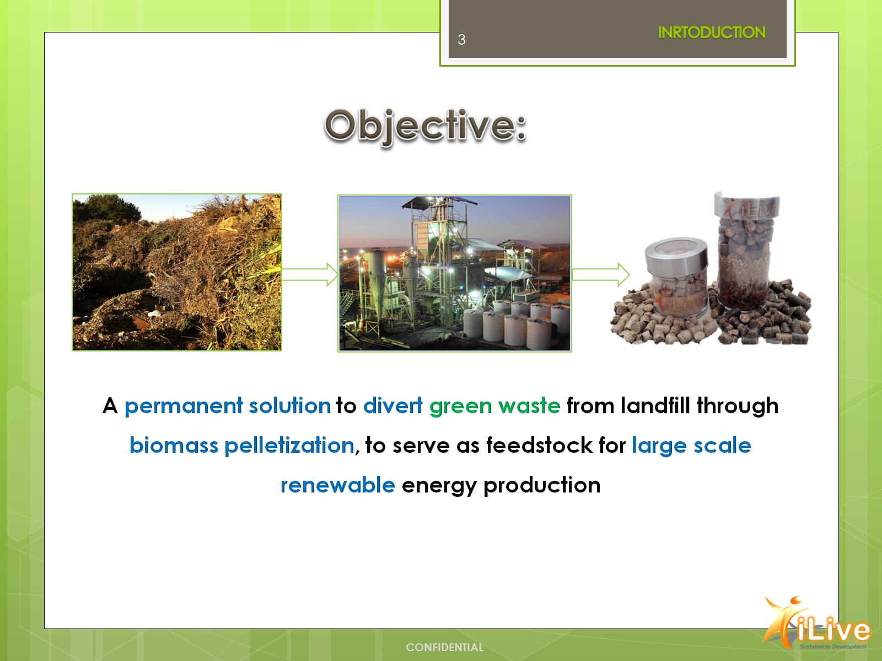

Slide 4
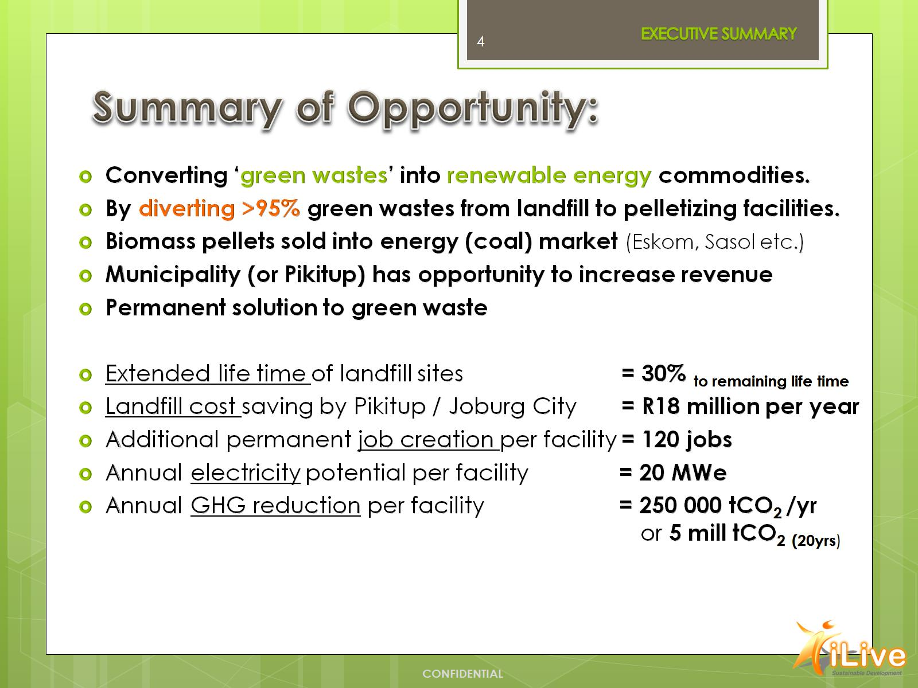
Summary of Opportunity:

Slide 5
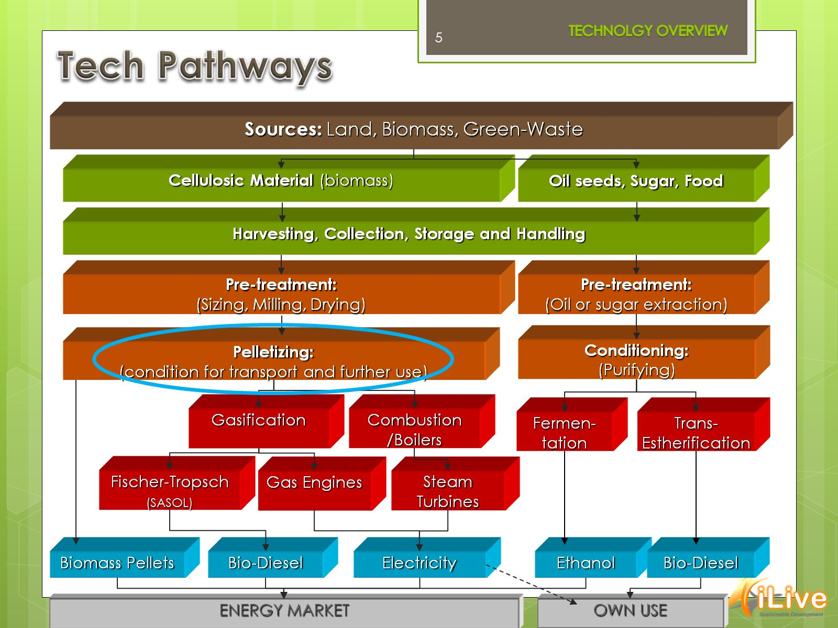

Slide 6
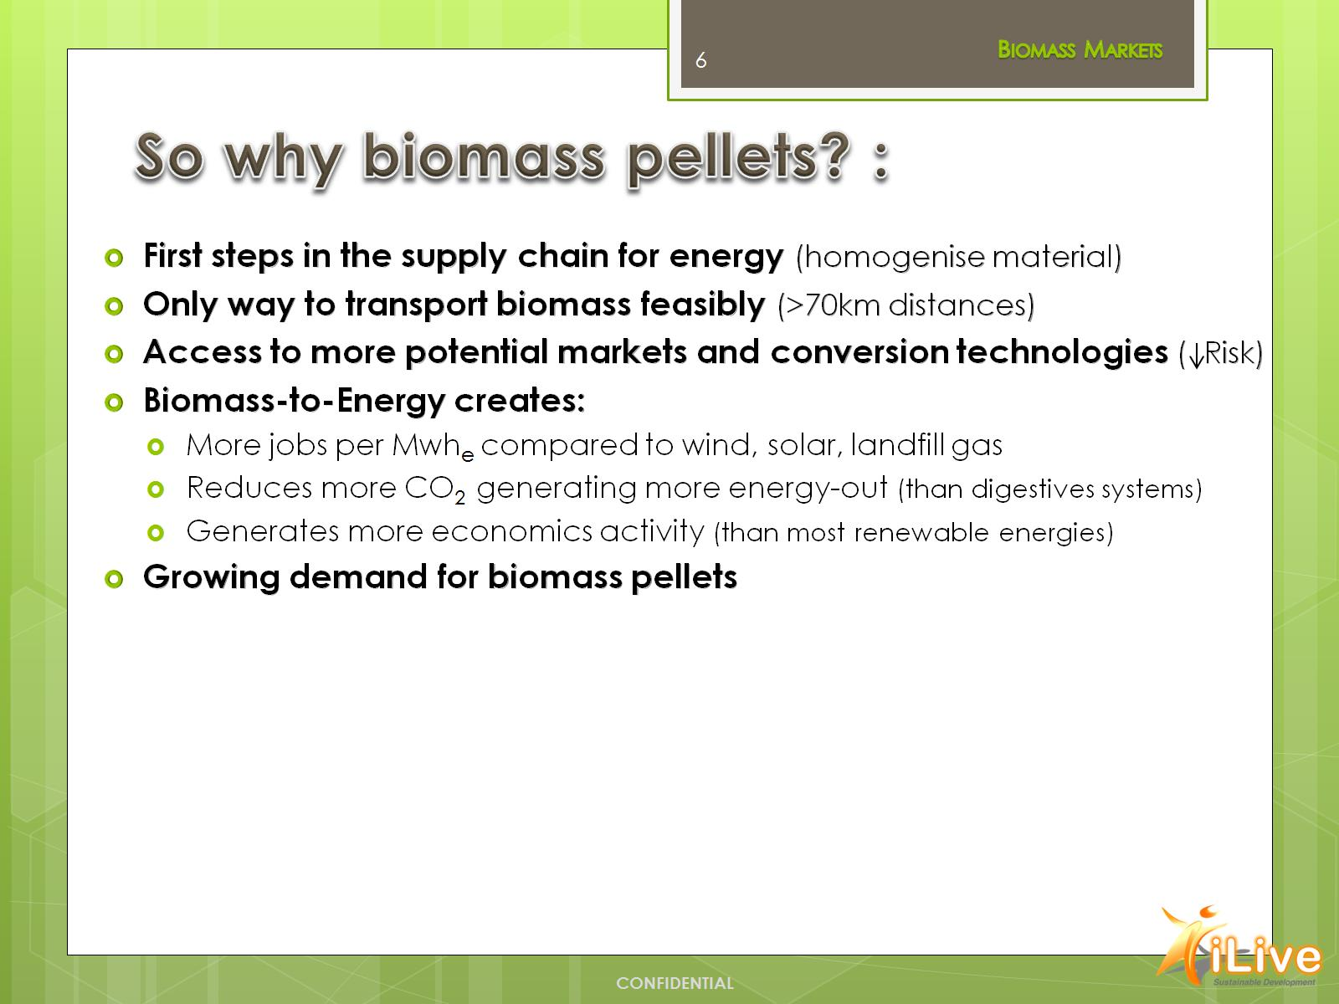
So why biomass pellets? :

Slide 7
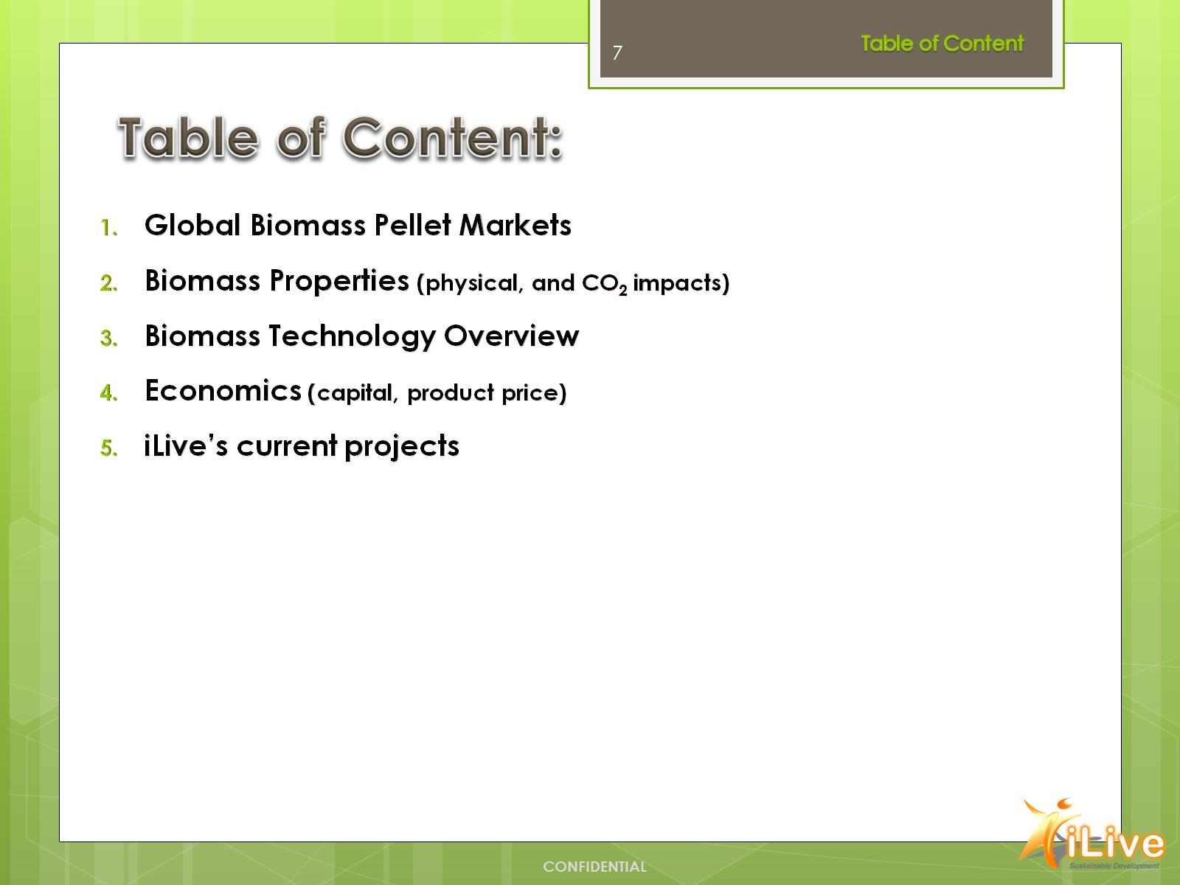
Table of Content:

Slide 8
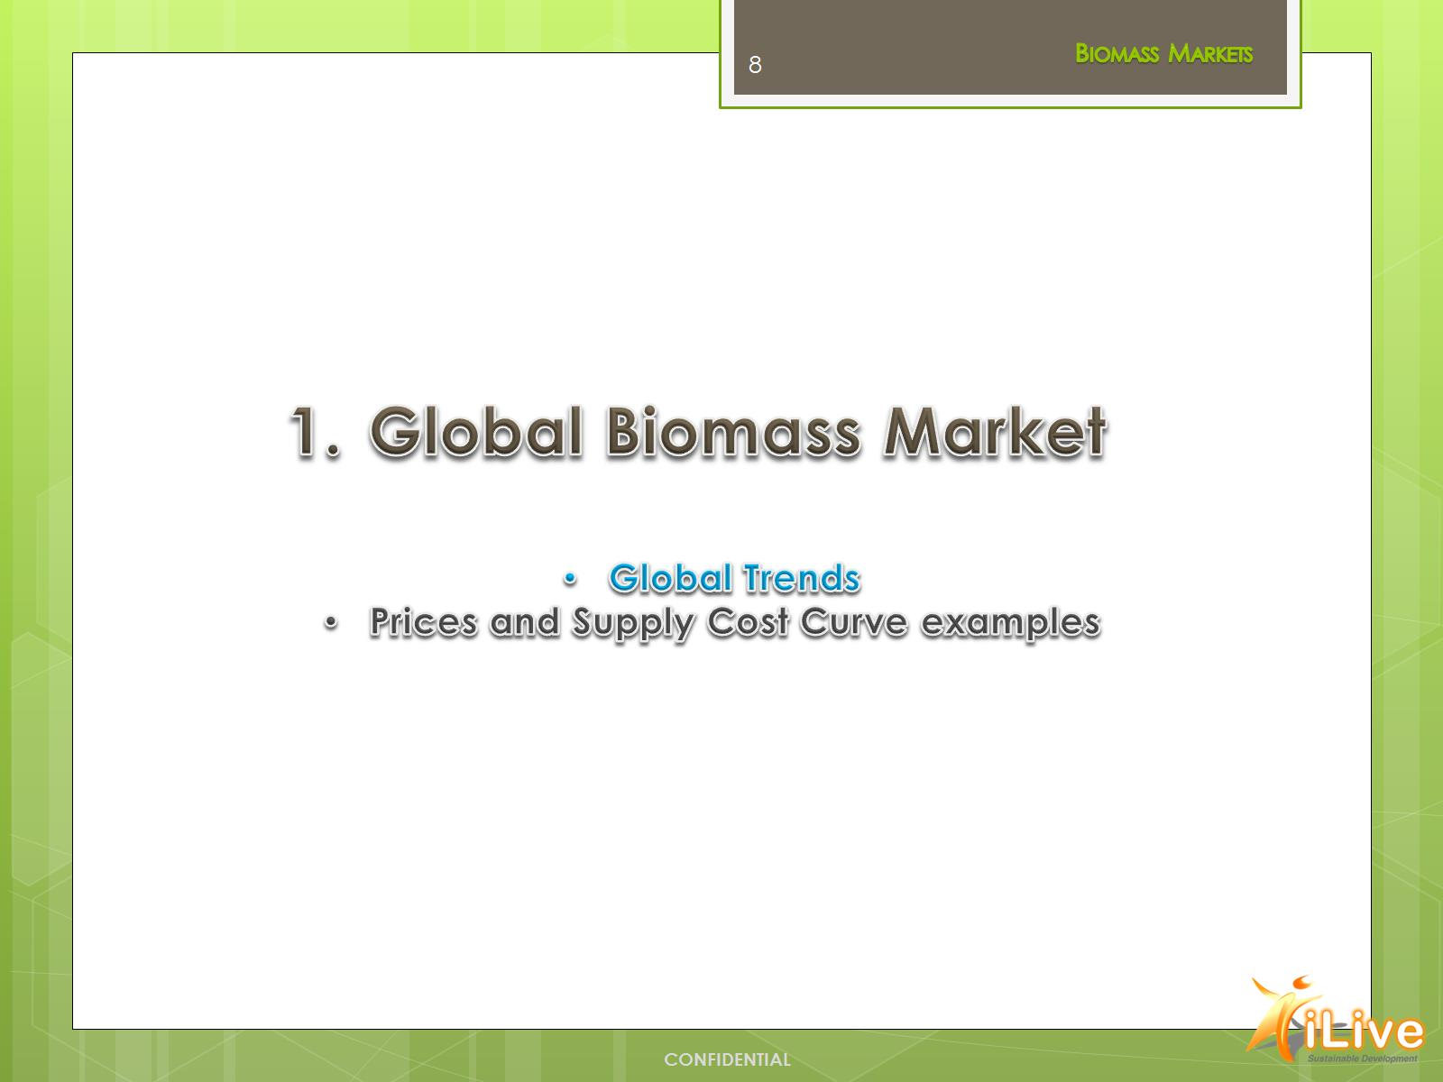

Slide 9
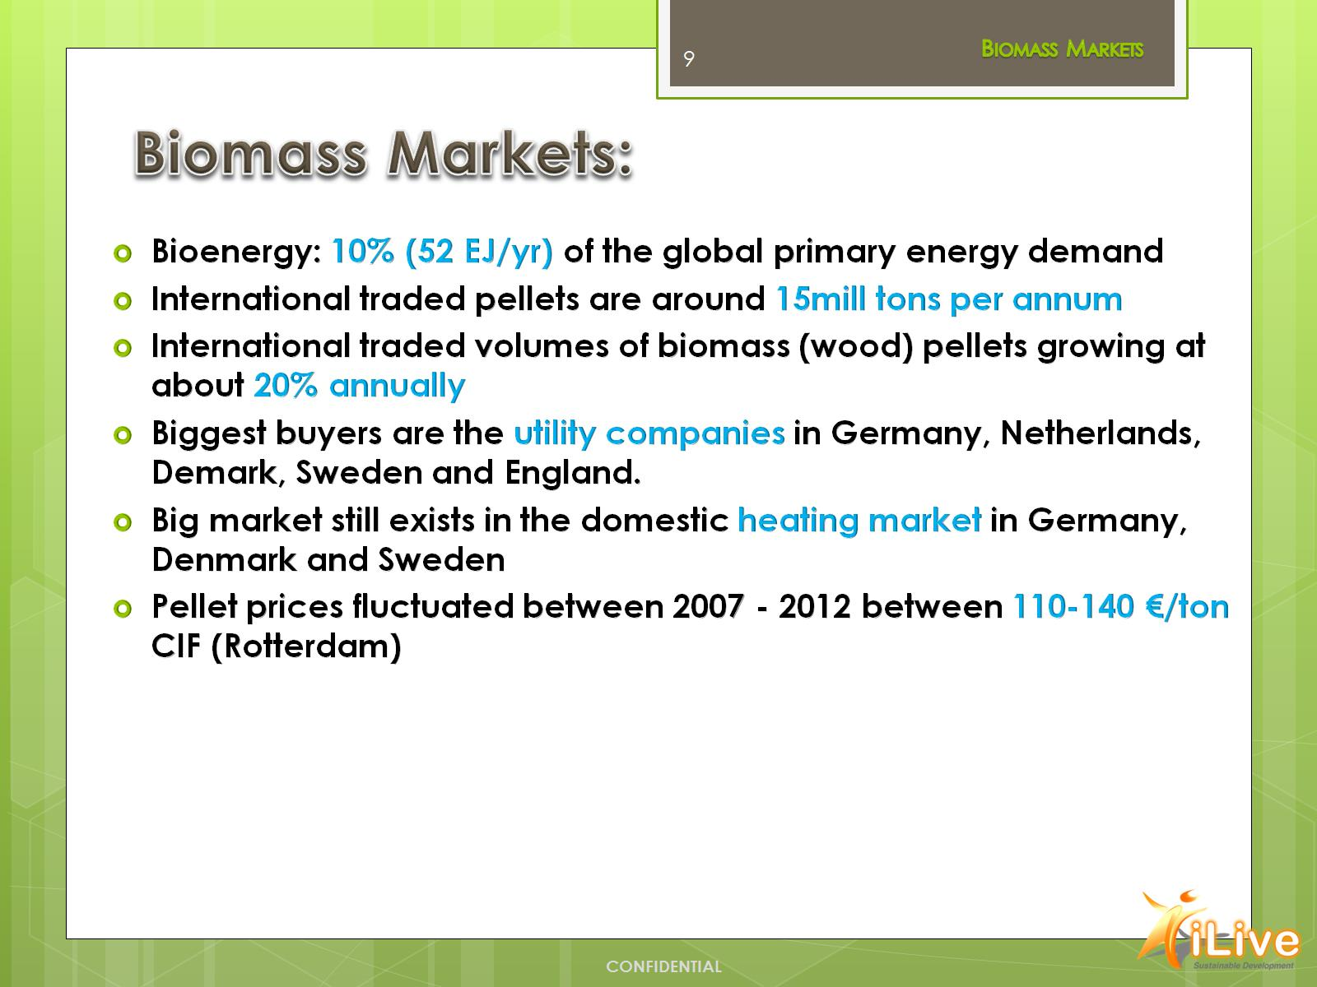
Biomass Markets:

Slide 10
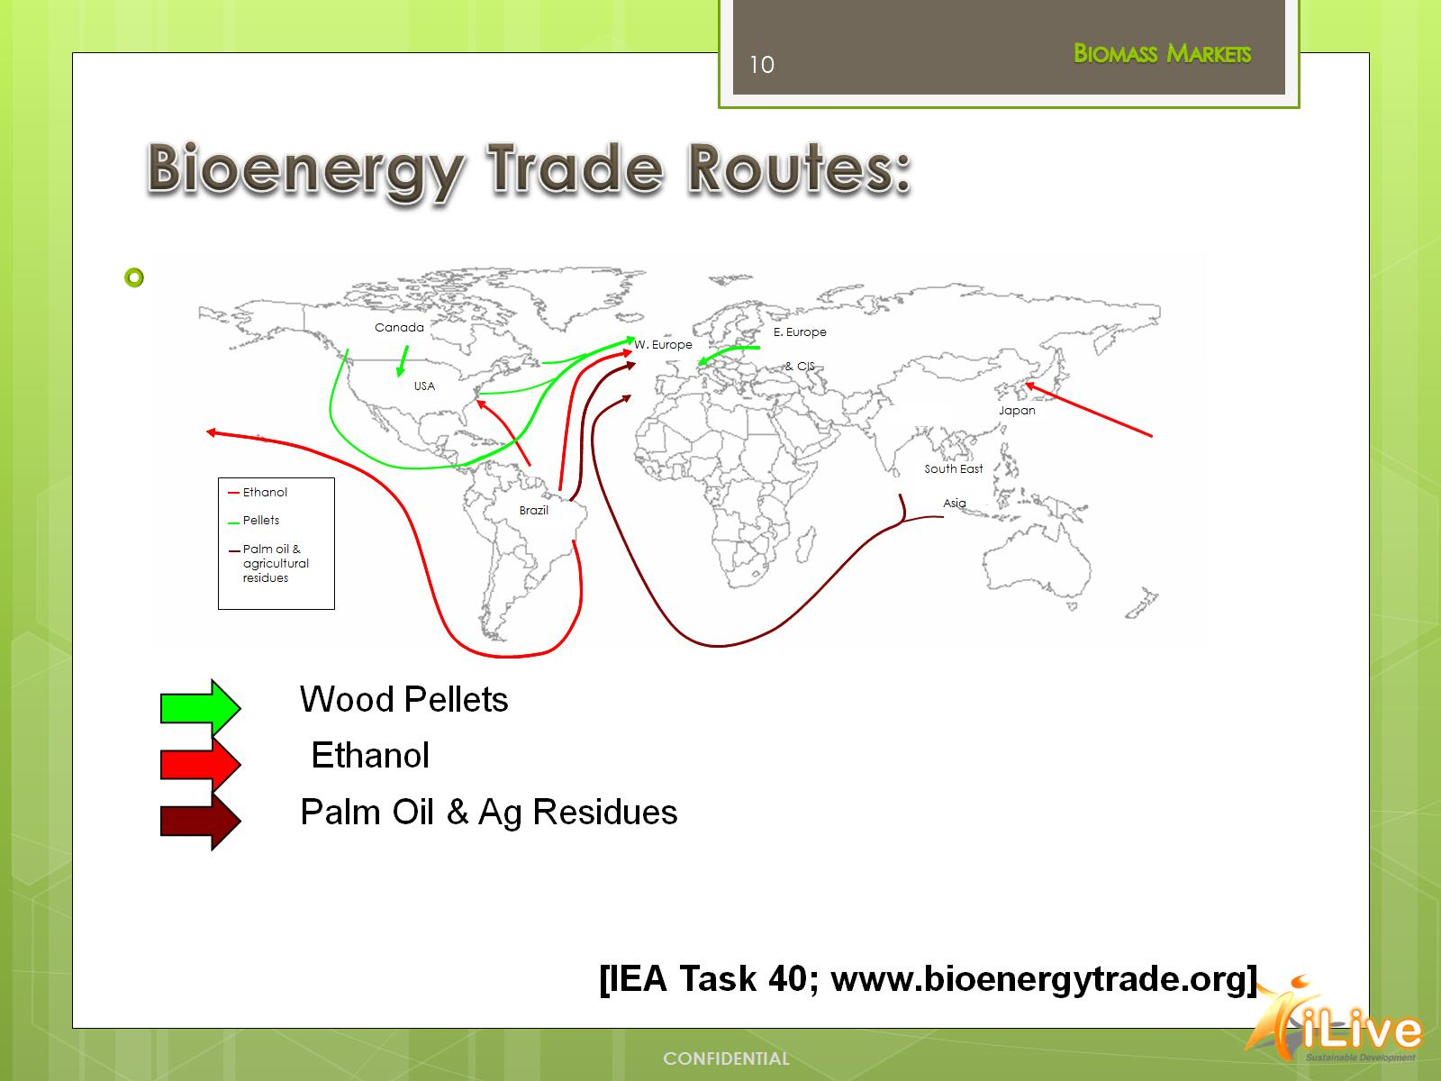
Bioenergy Trade Routes:

Slide 11
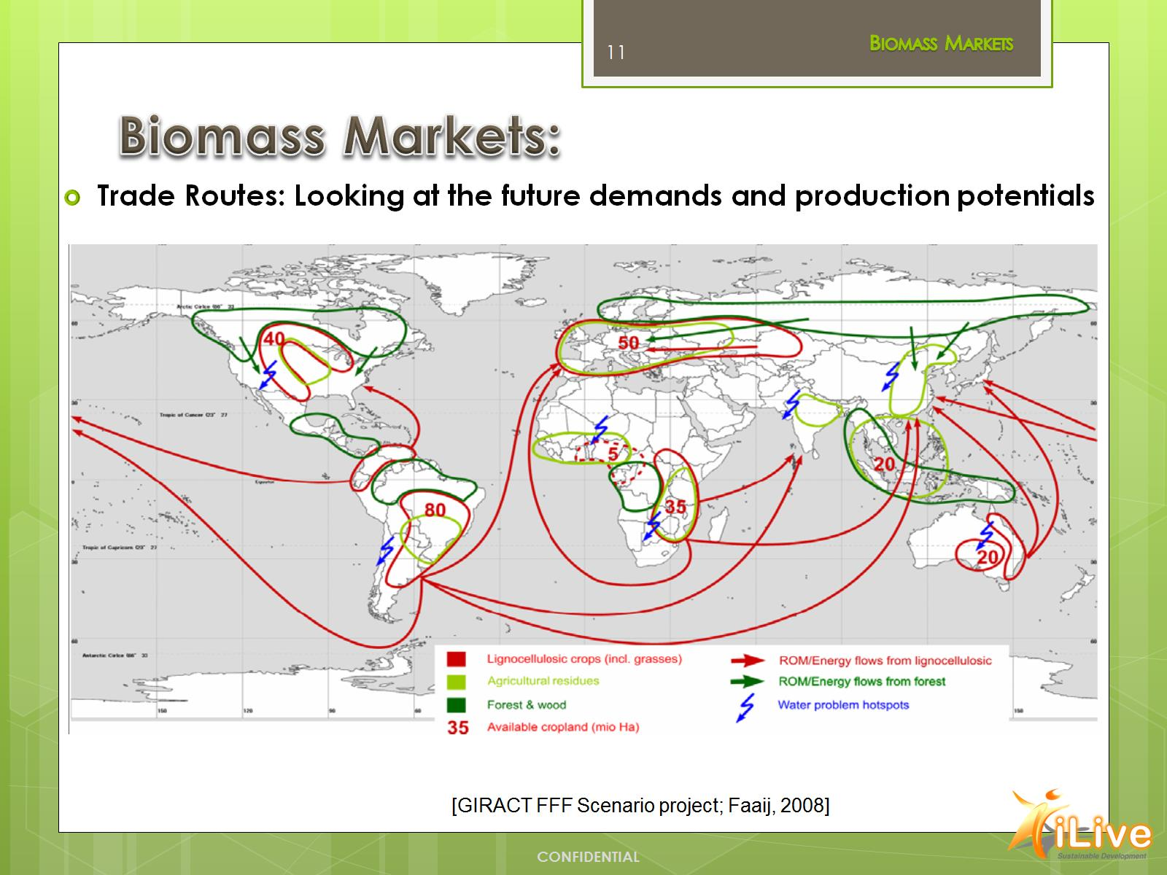
Biomass Markets:

Slide 12
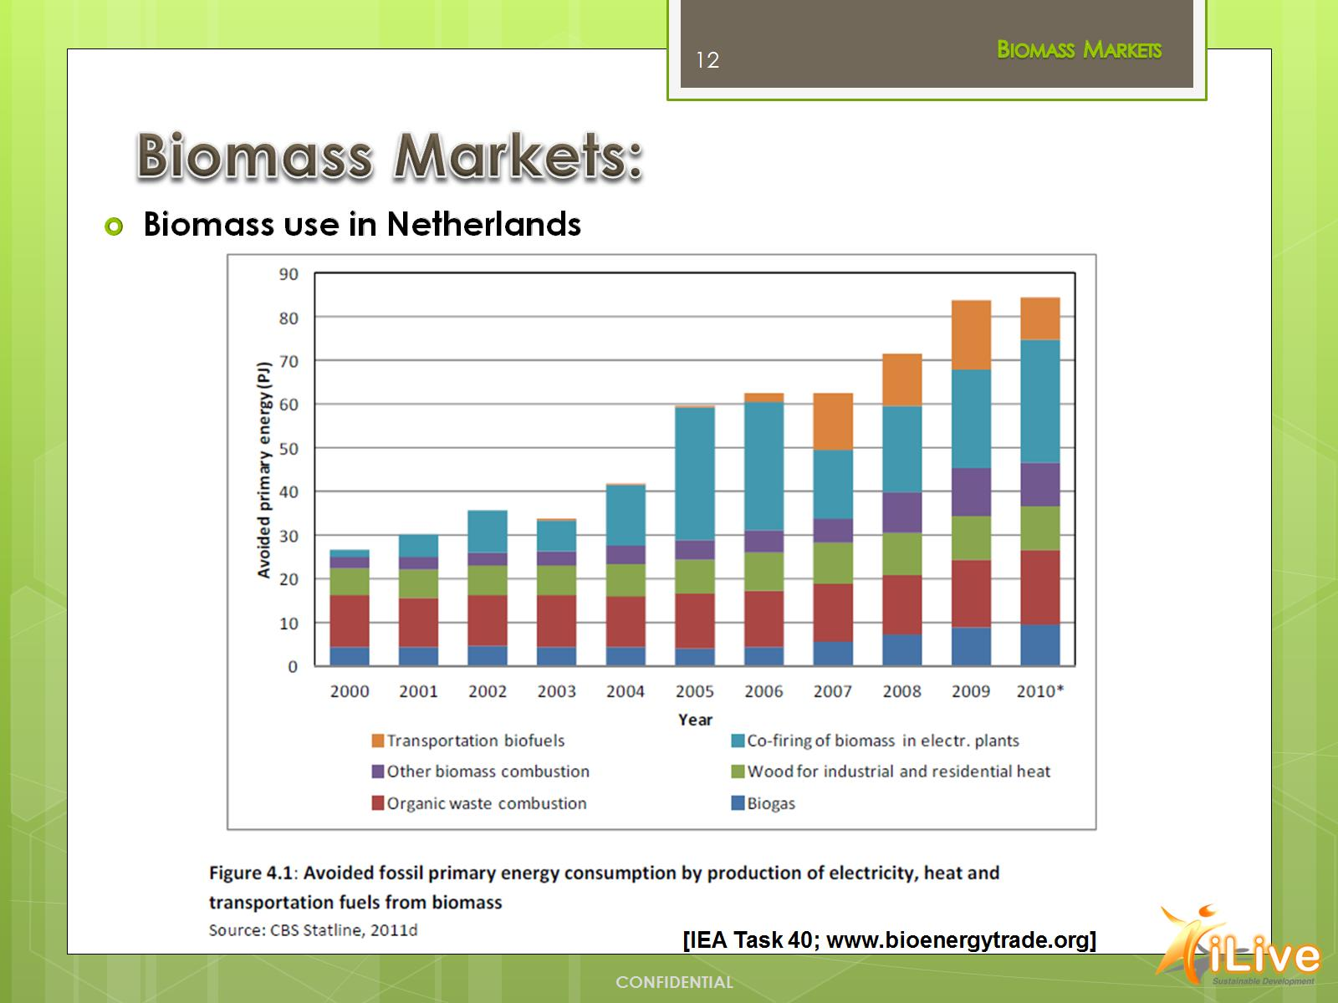
Biomass Markets:

Slide 13
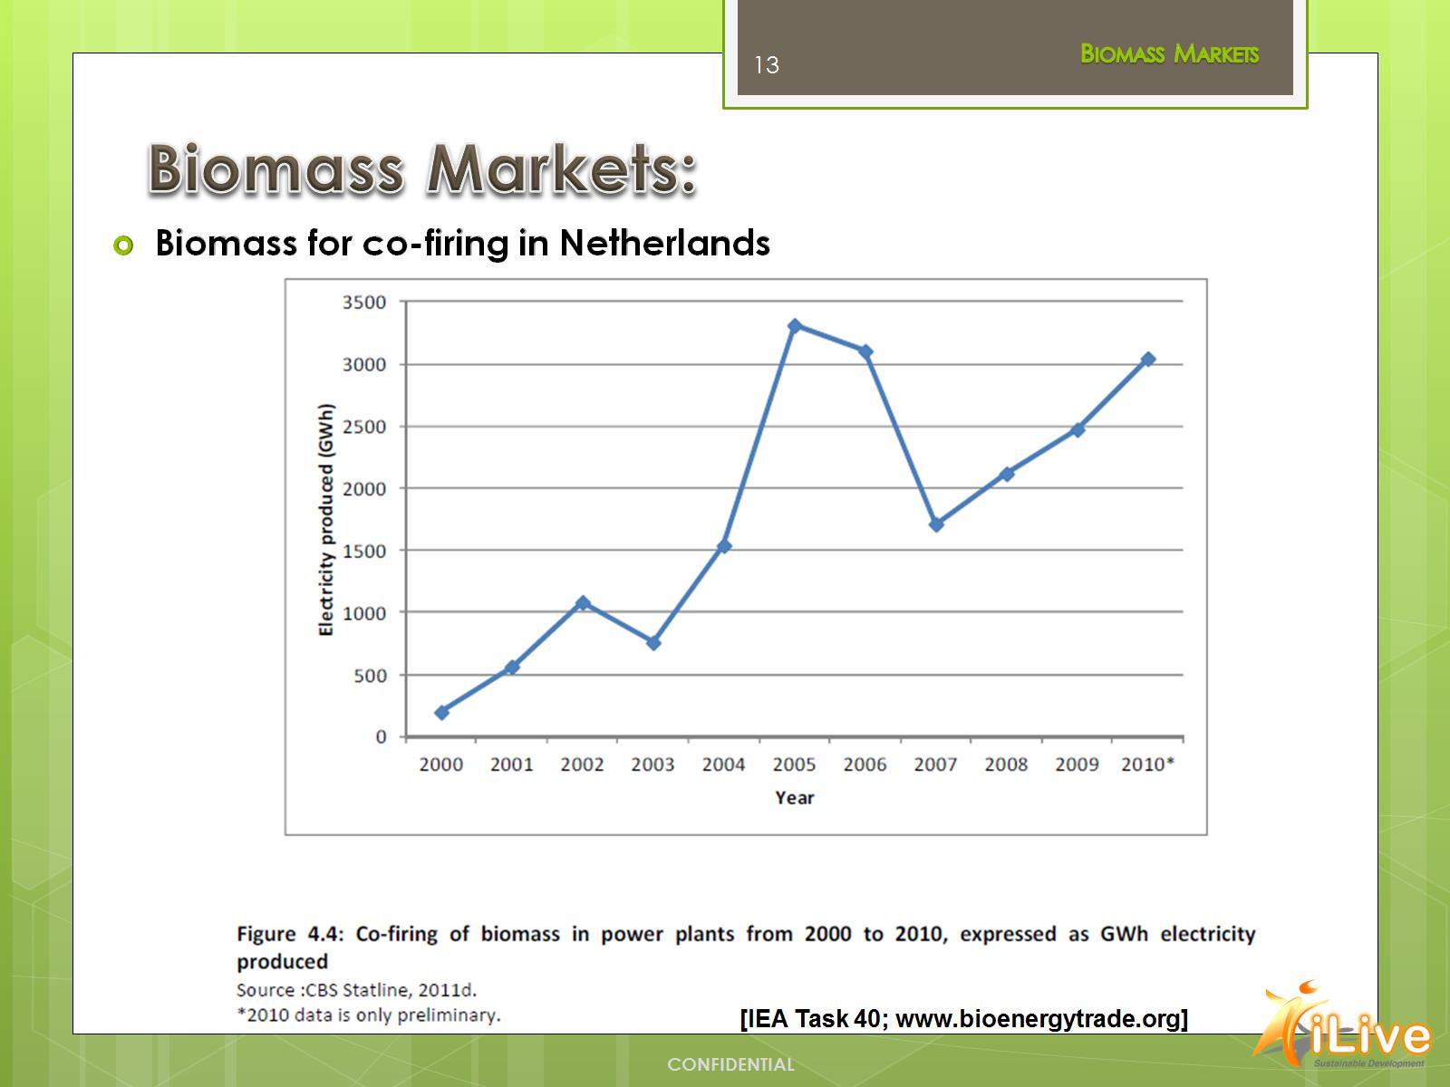
Biomass Markets:

Slide 14
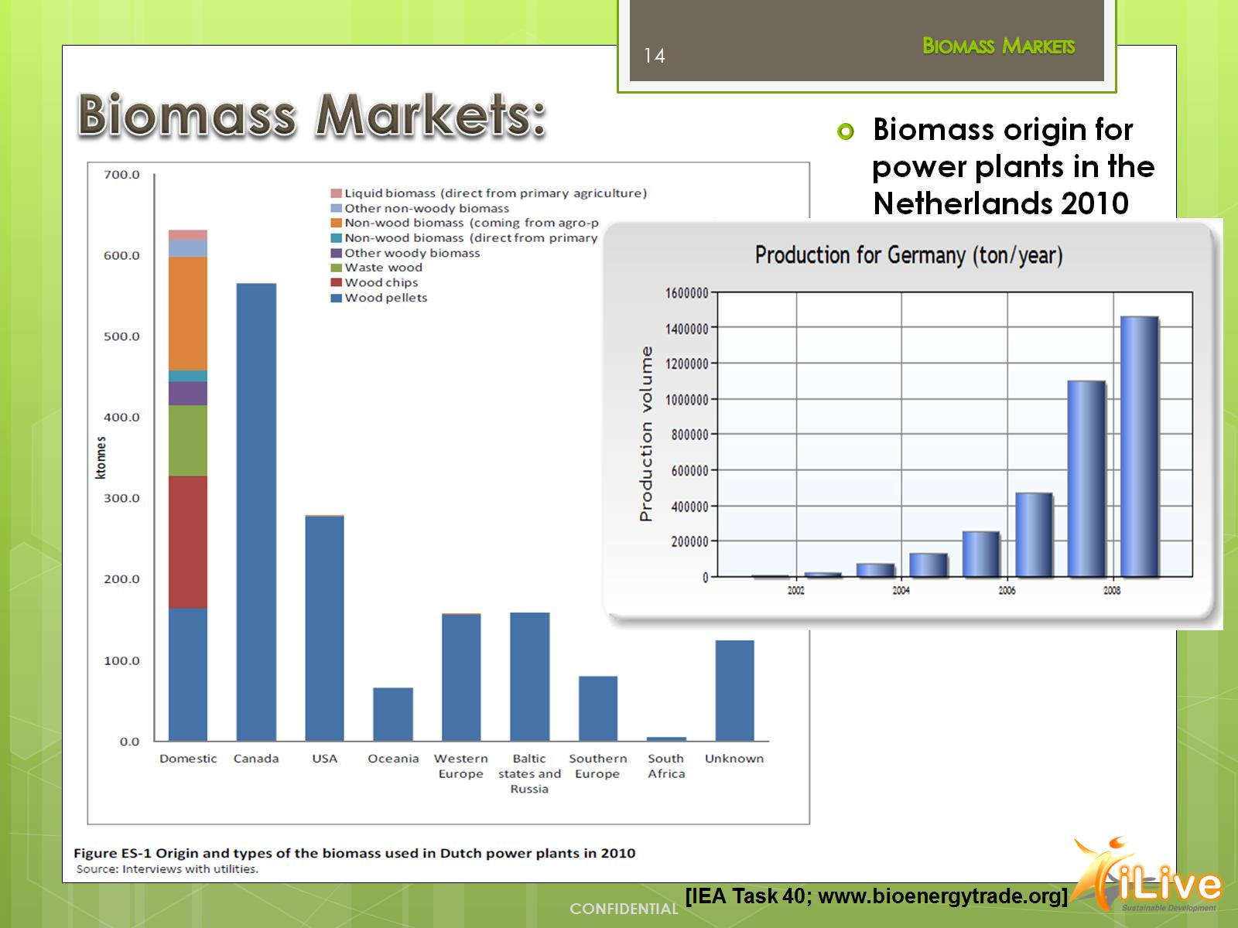
Biomass Markets:

Slide 15
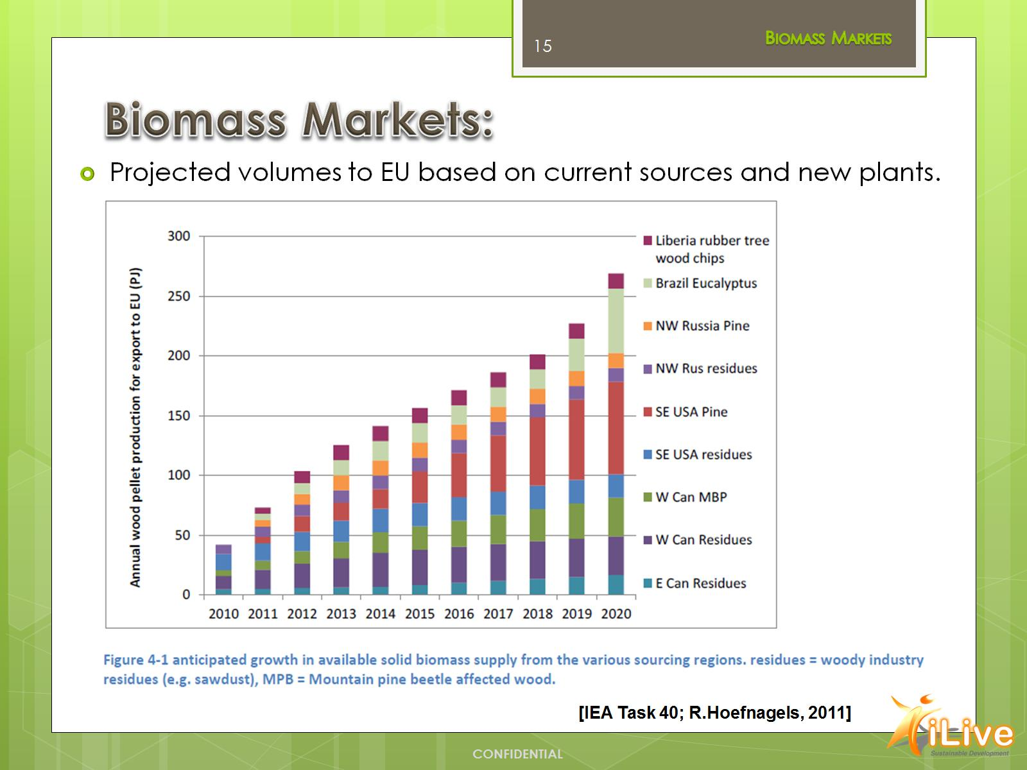
Biomass Markets:

Slide 16
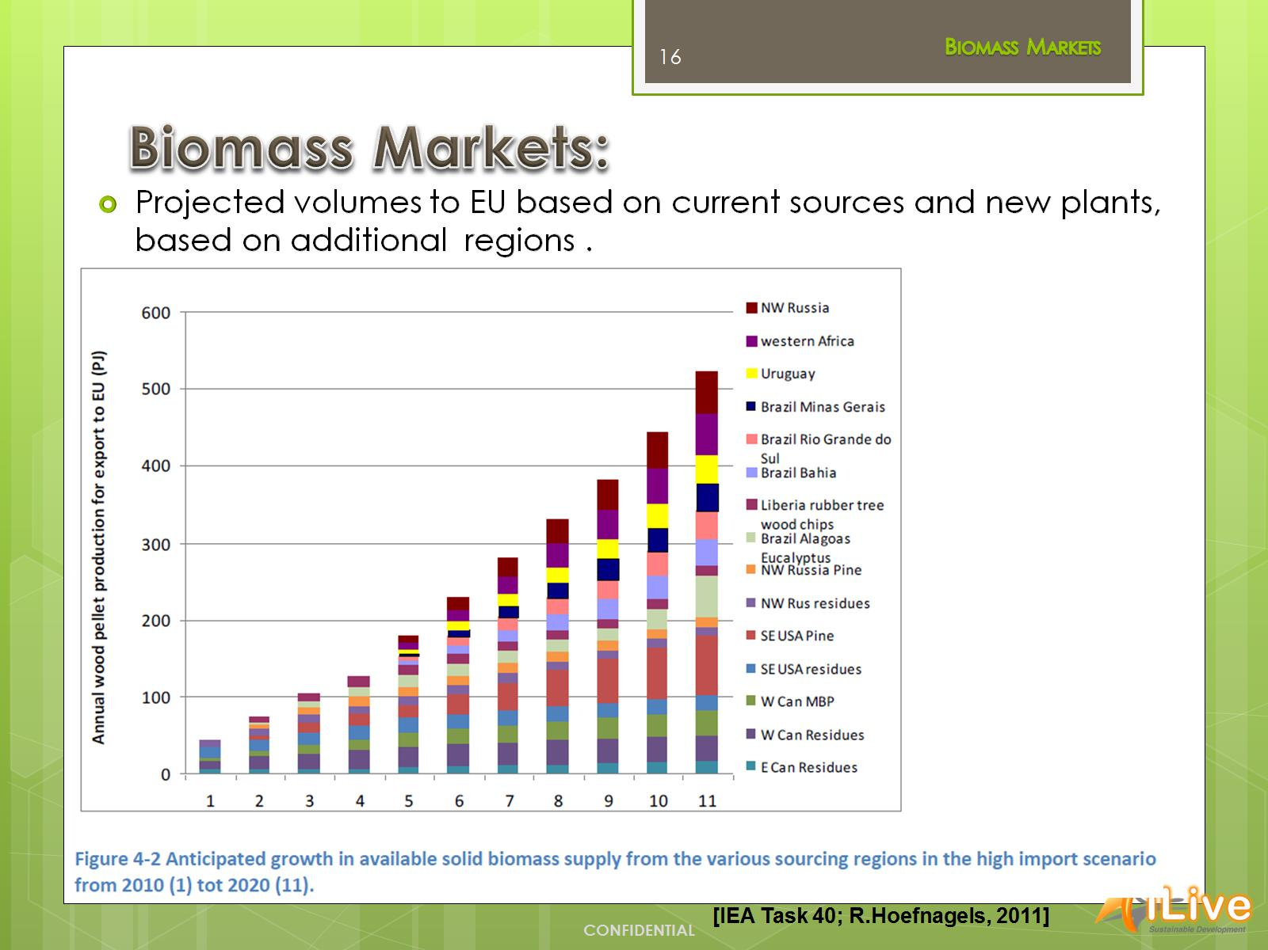
Biomass Markets:

Slide 17
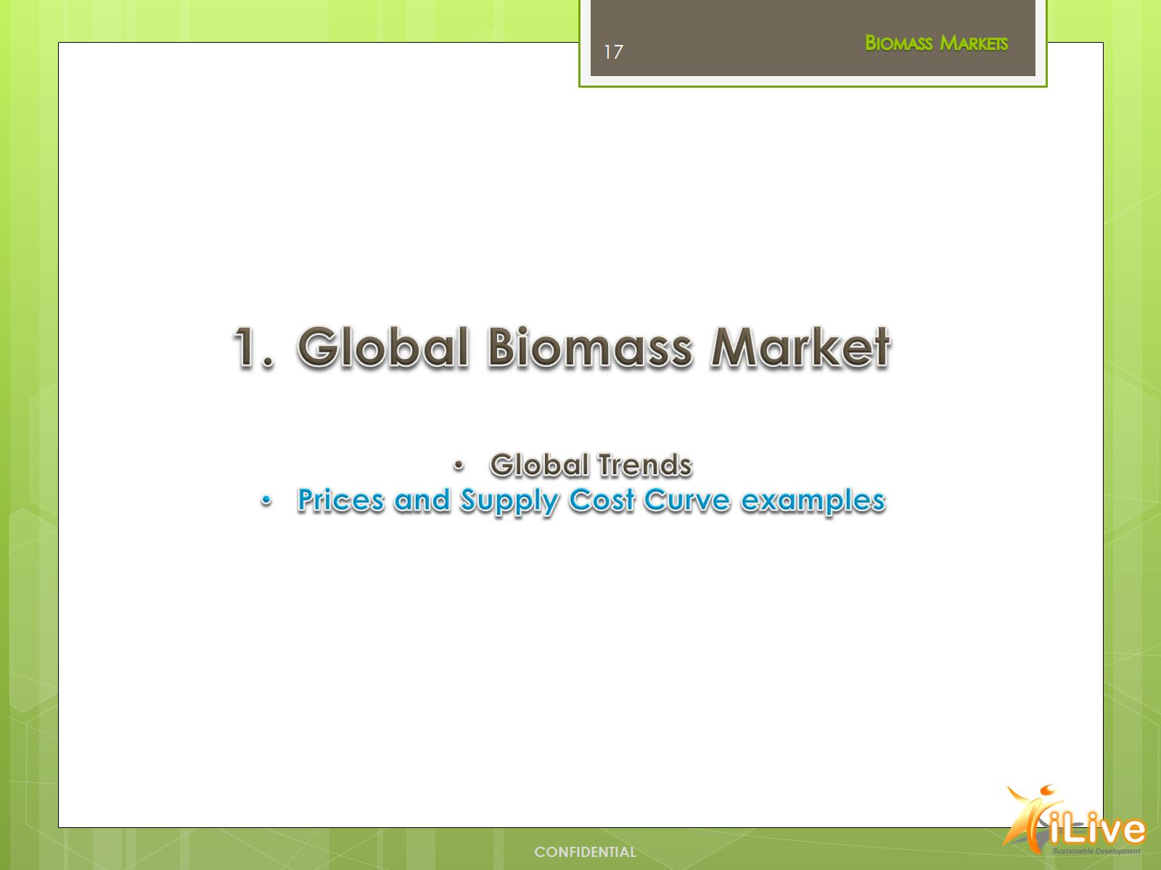

Slide 18
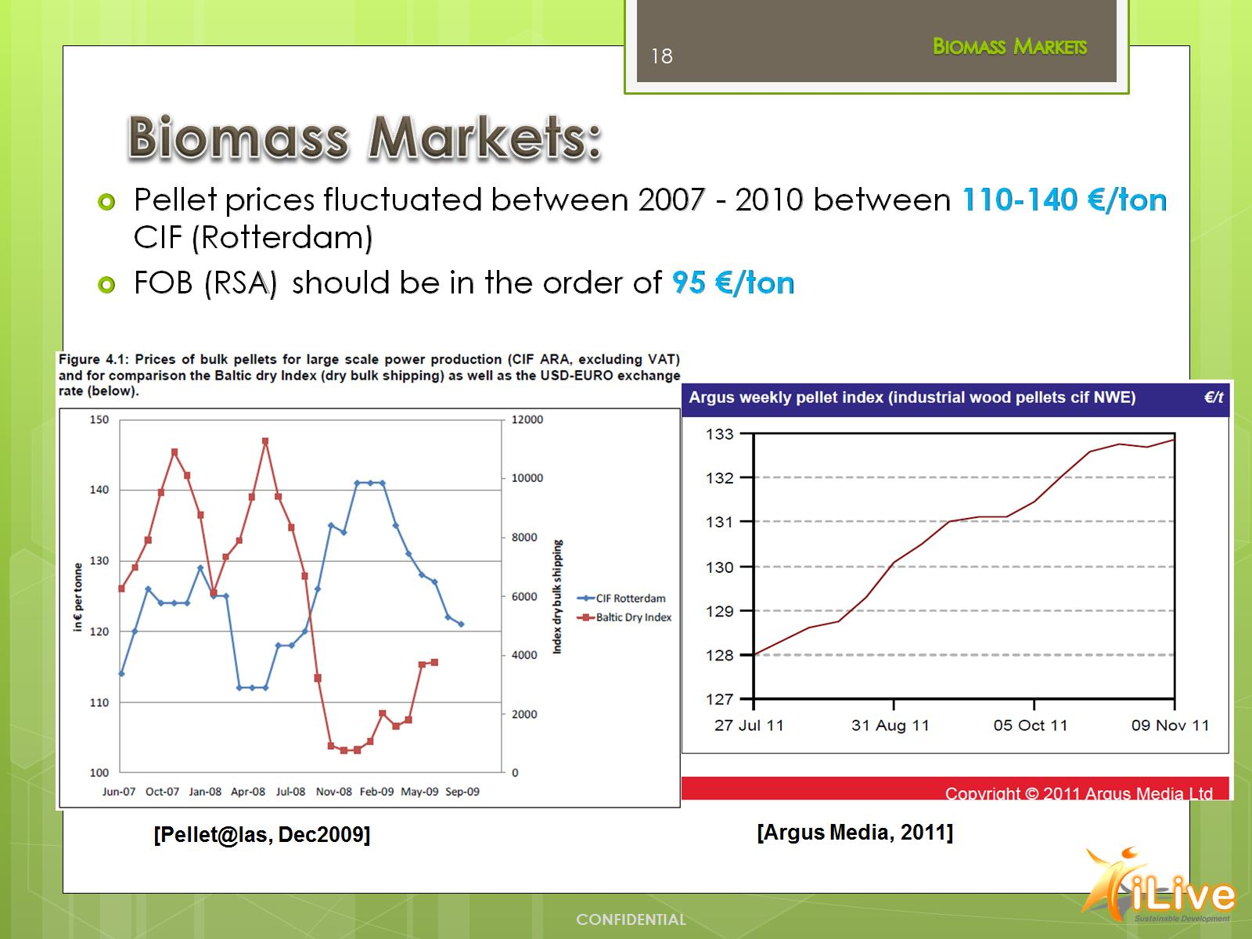
Biomass Markets:

Slide 19
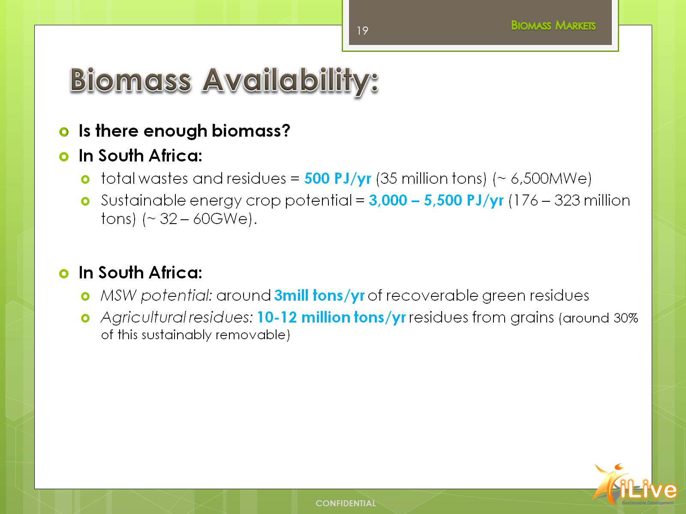
Biomass Availability:

Slide 20
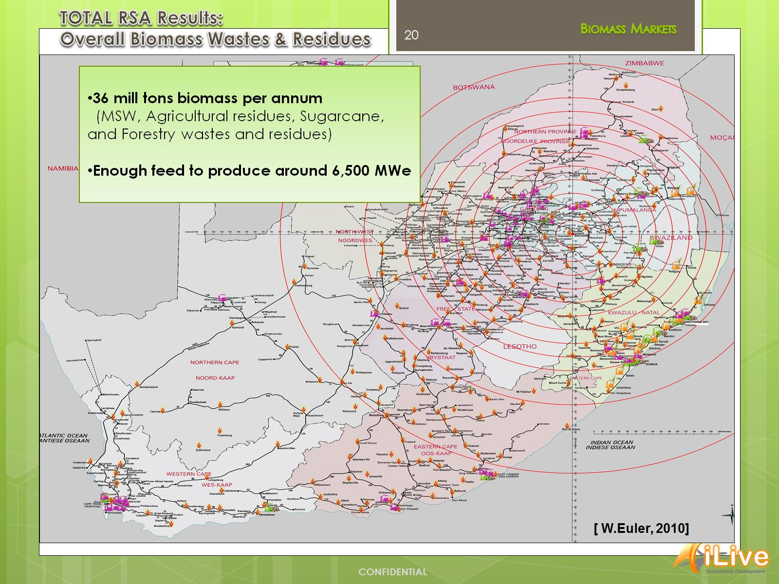

Slide 21
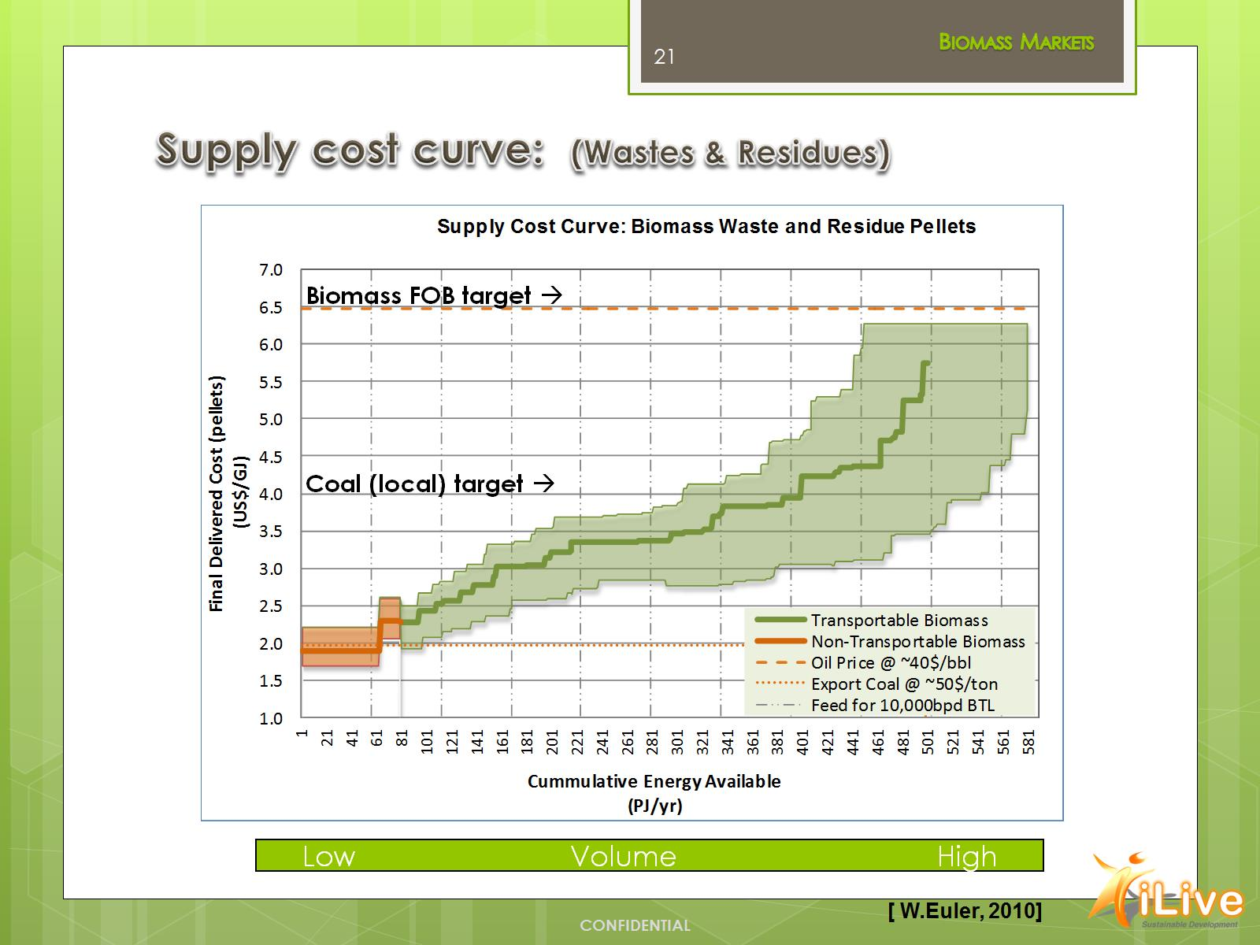
Supply cost curve: (Wastes & Residues)

Slide 22
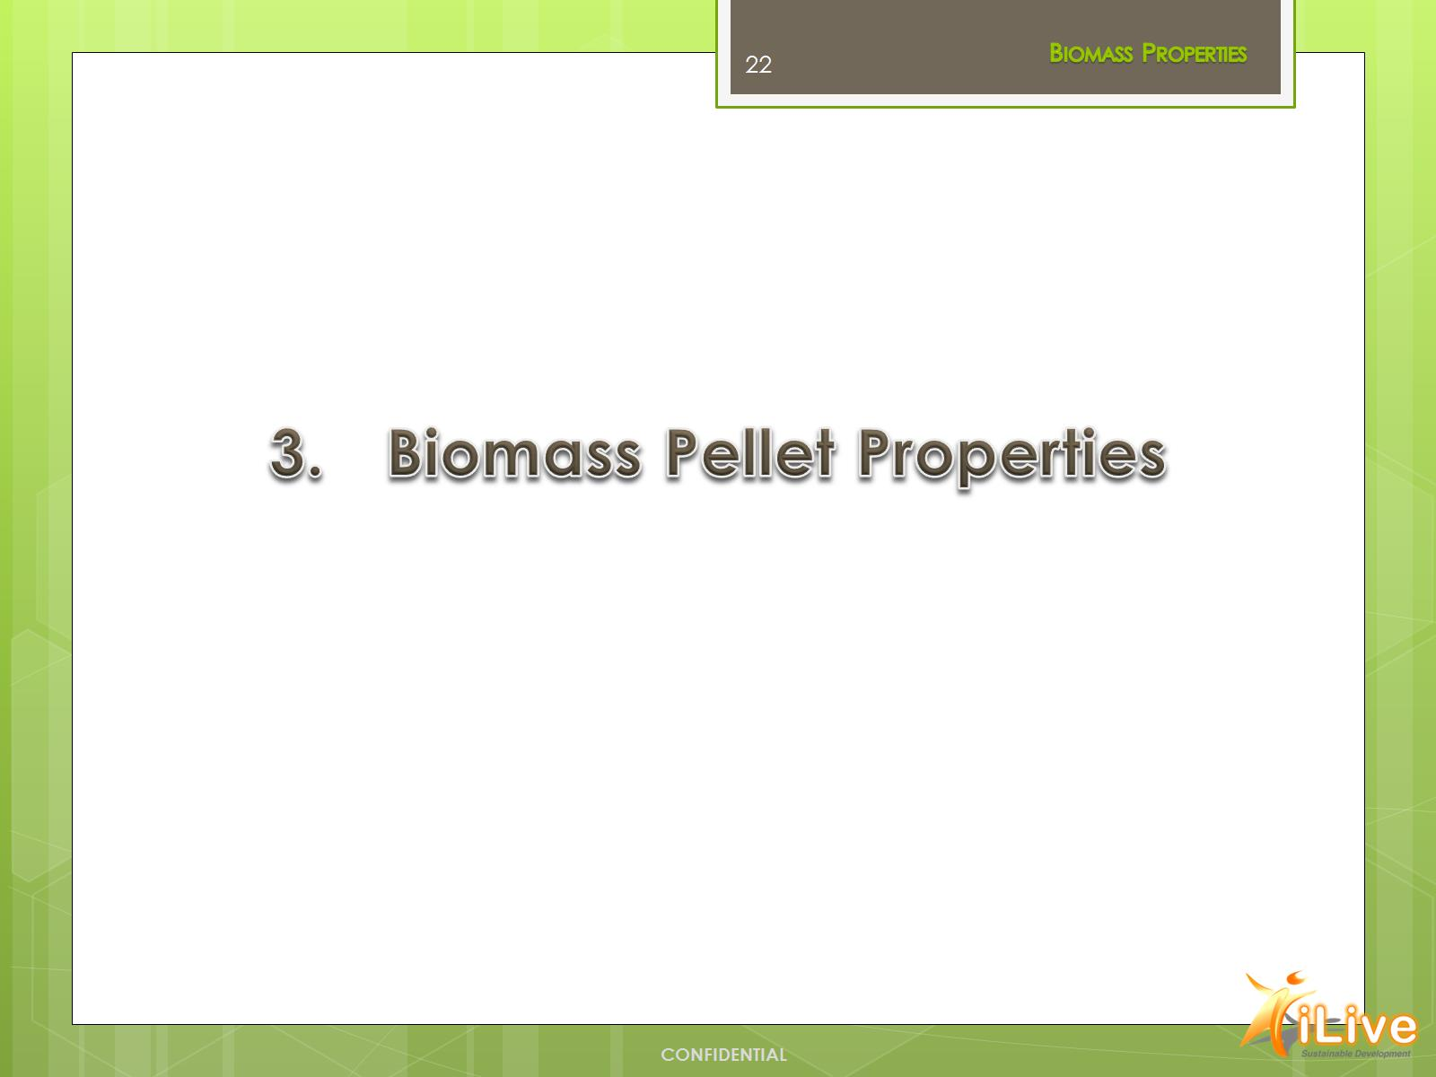

Slide 23
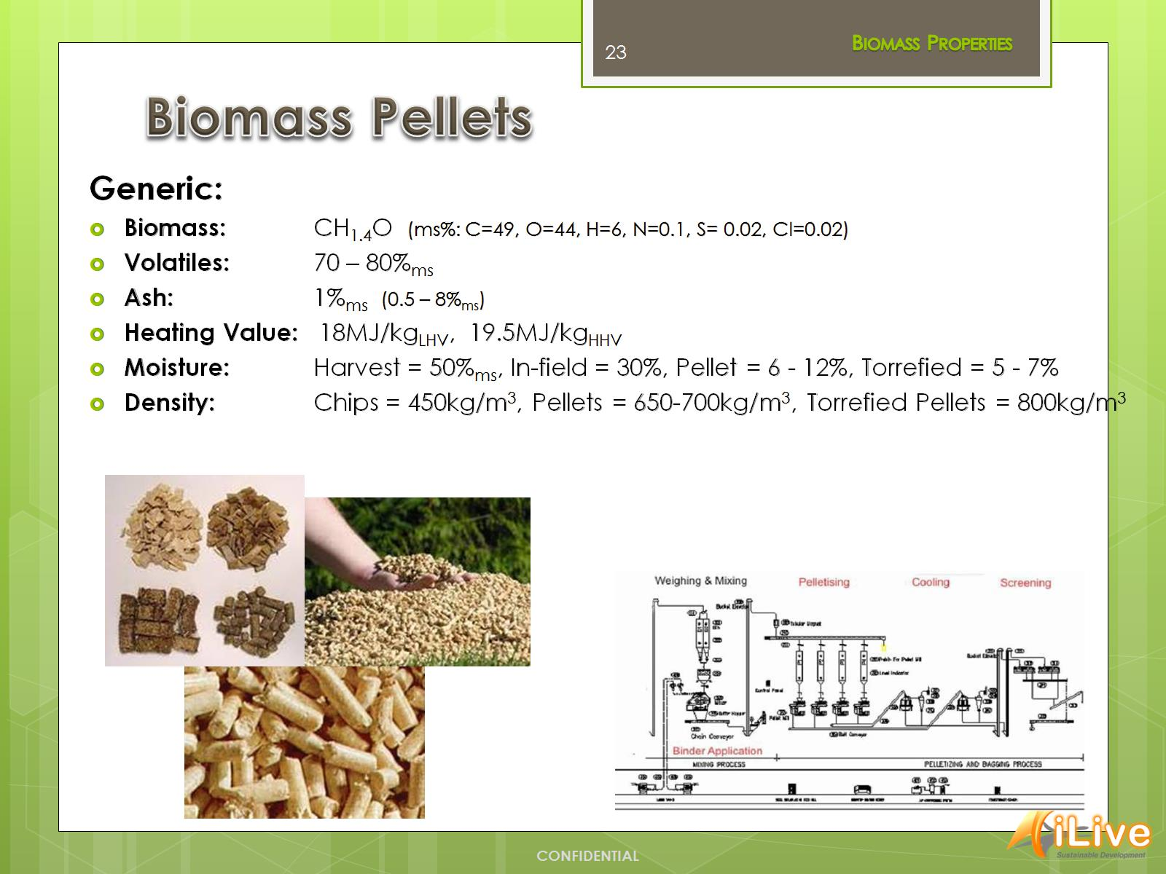
Biomass Pellets

Slide 24
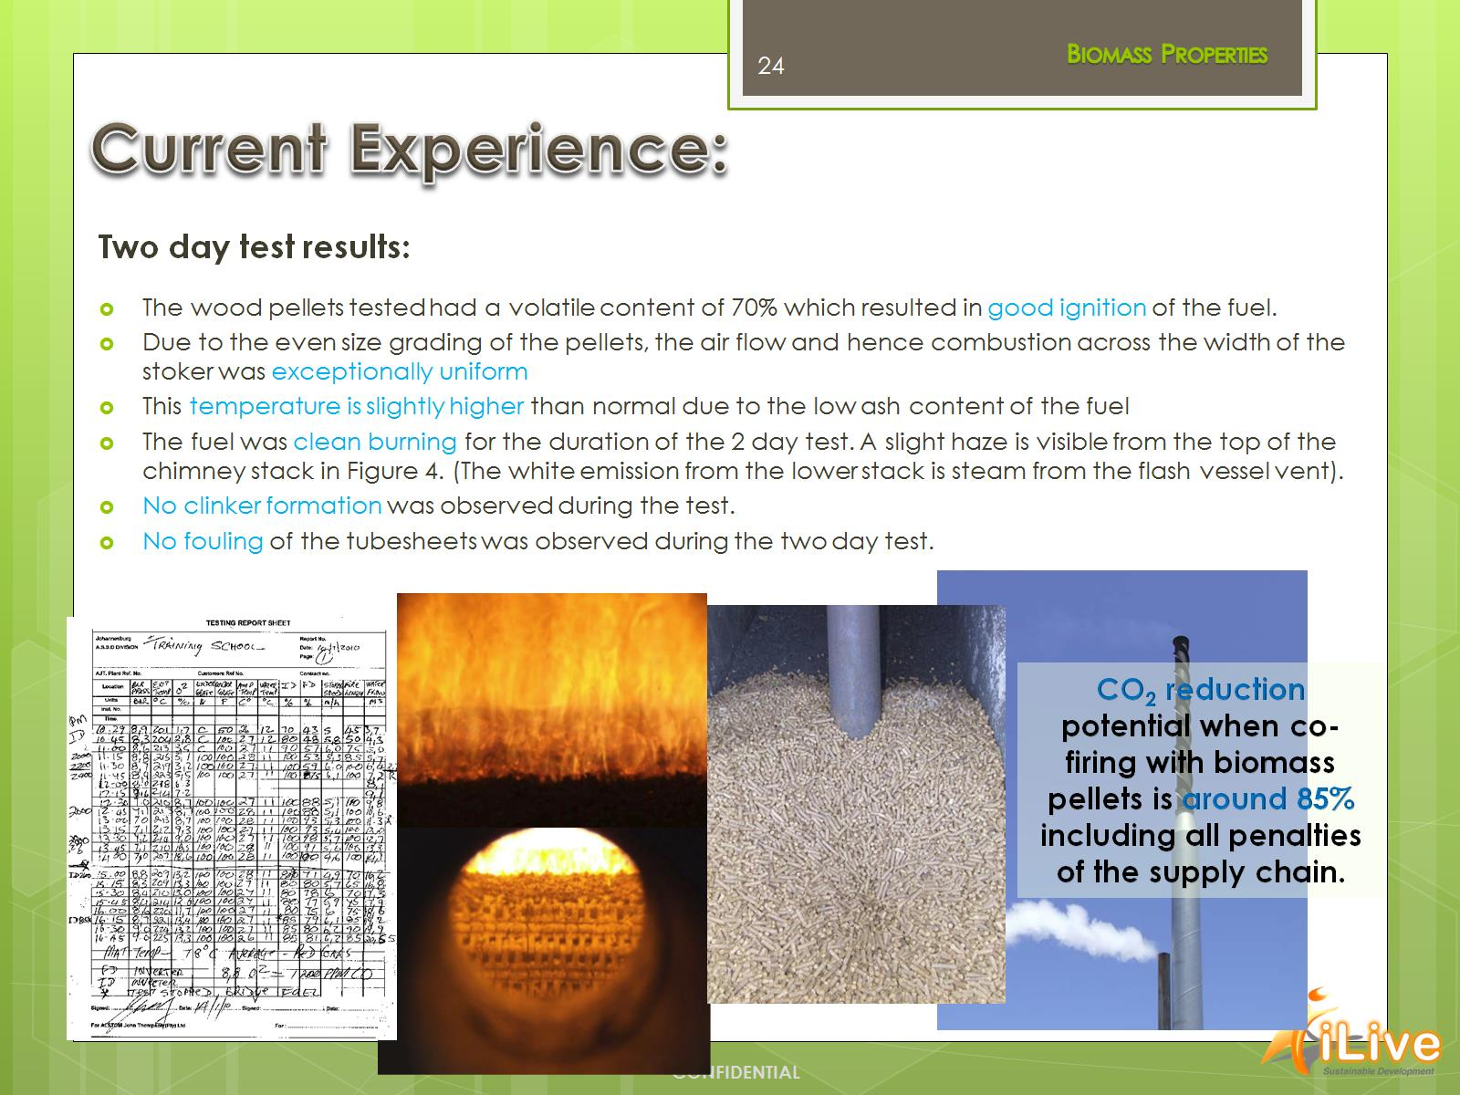
Current Experience:

Slide 25
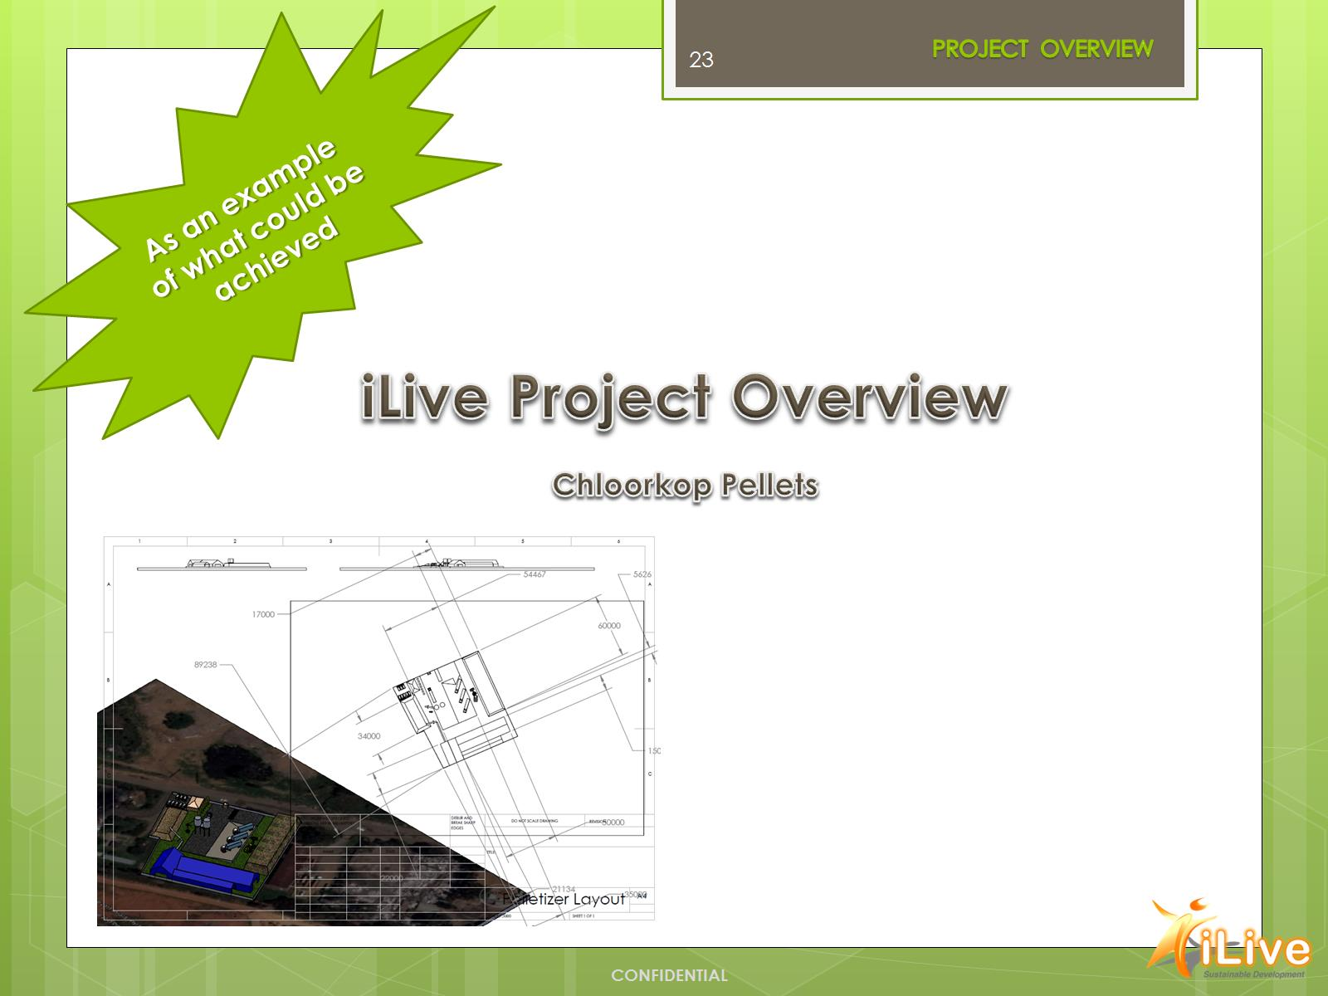

Slide 26
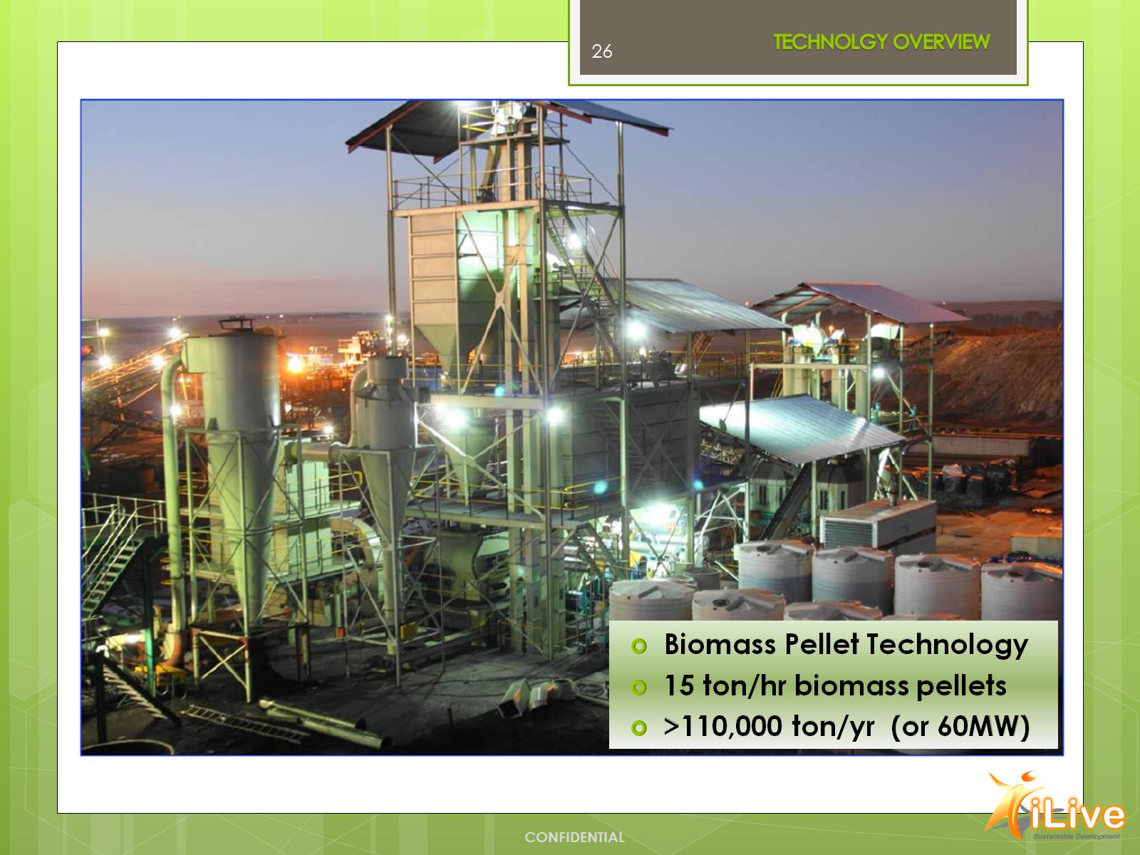

Slide 27
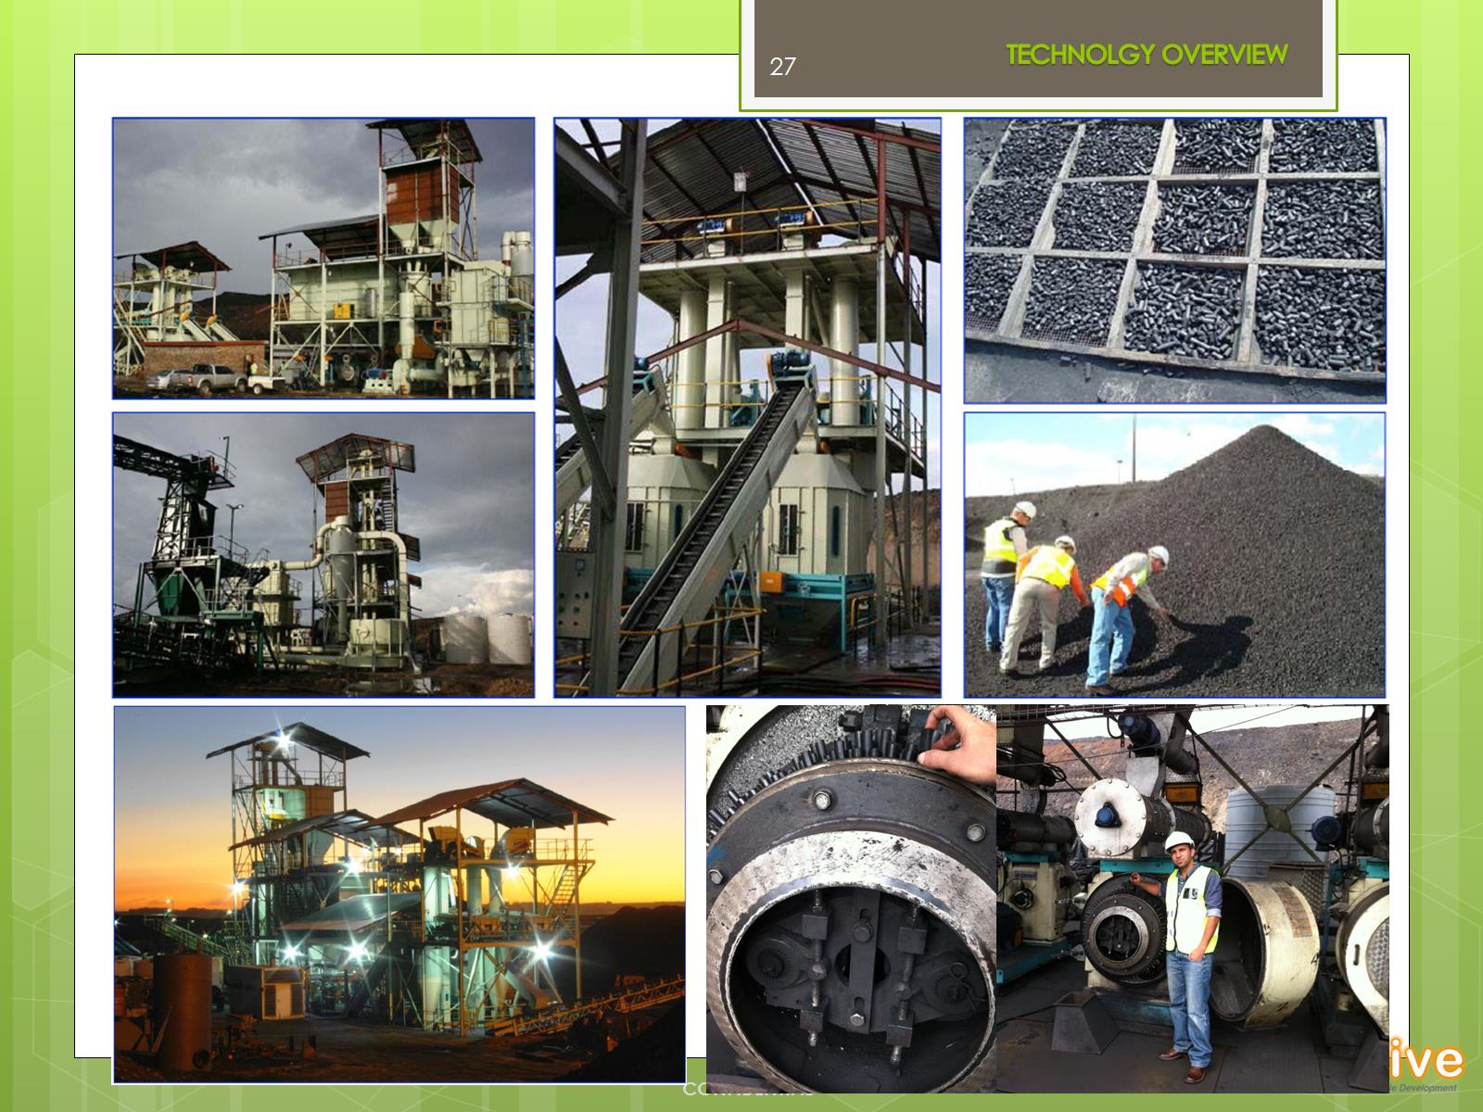

Slide 28
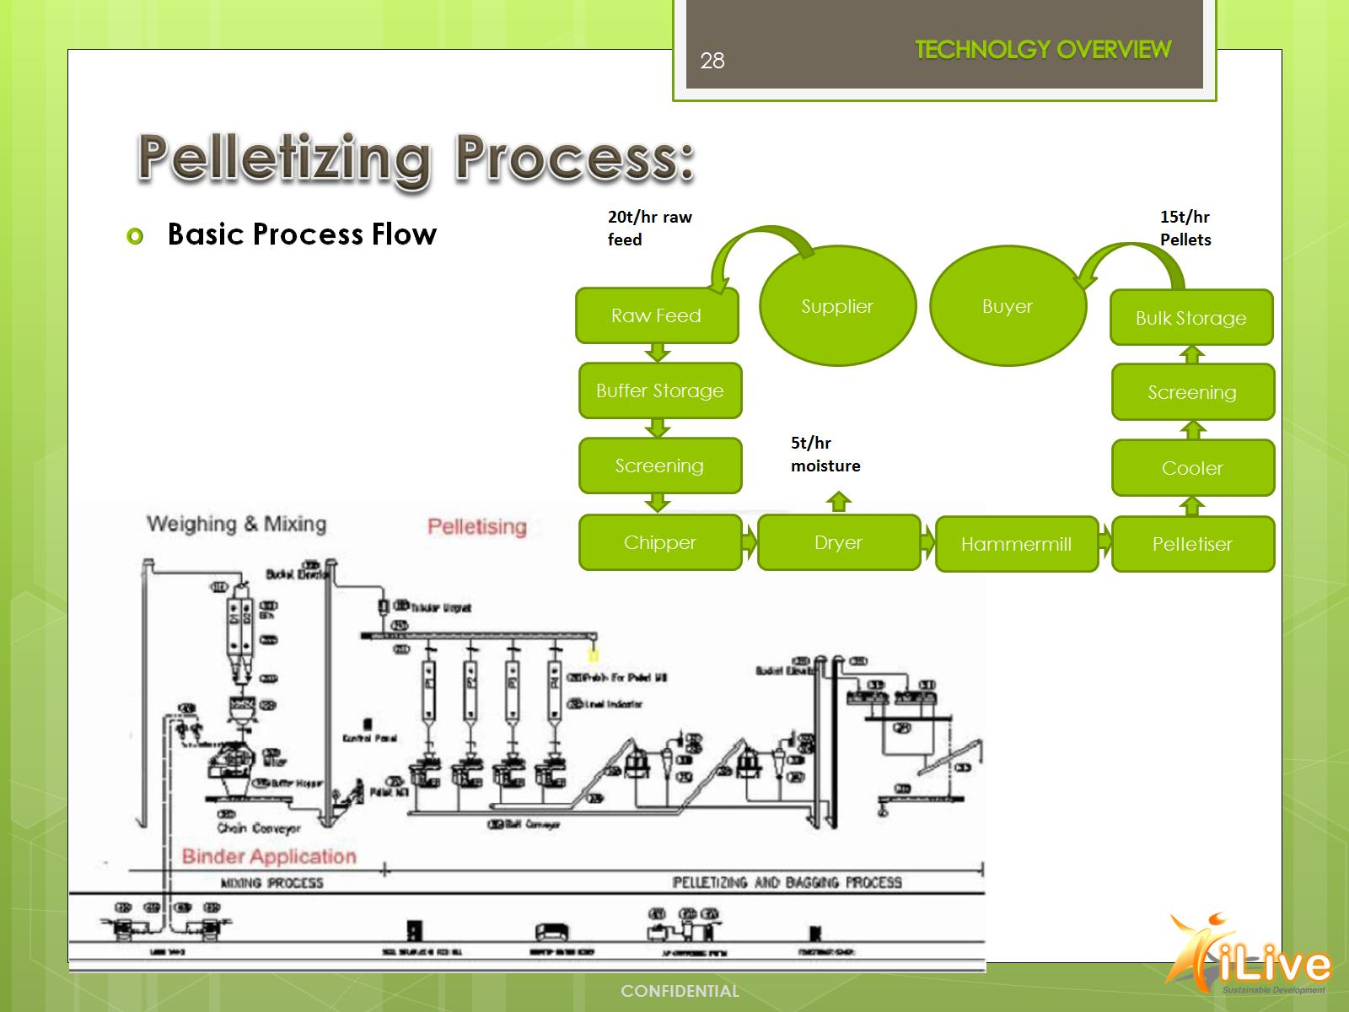
Pelletizing Process:

Slide 29
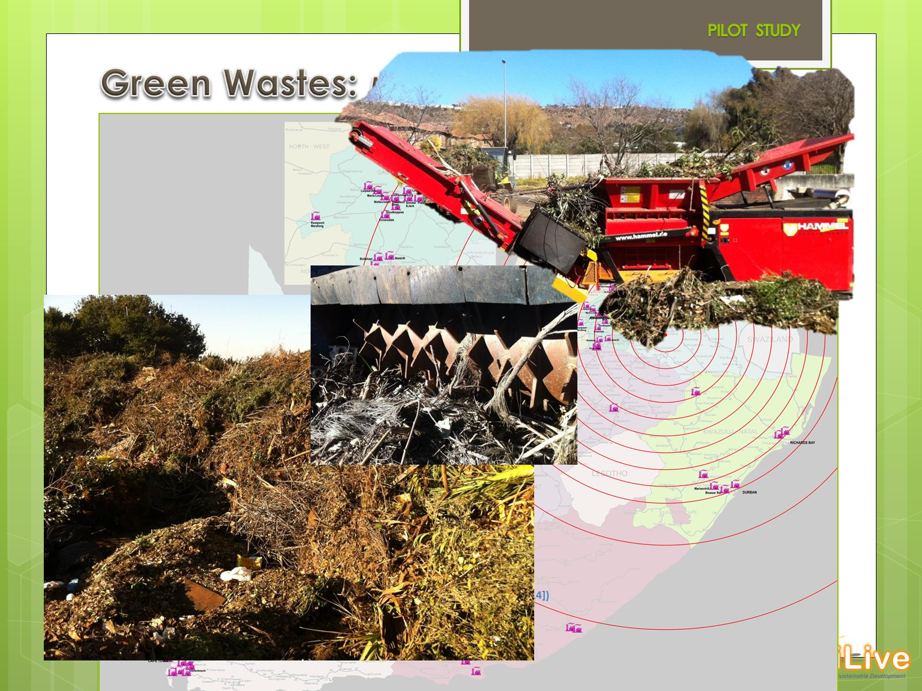
Green Wastes: MSW /RDF

Slide 30
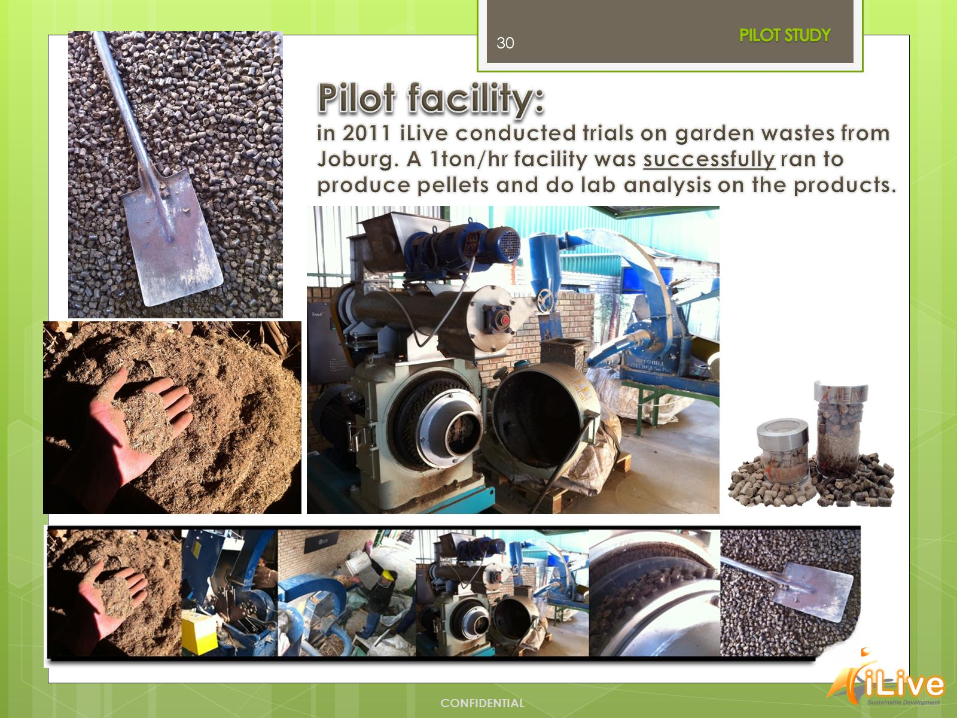
Pilot facility: in 2011 iLive conducted trials on garden wastes from Joburg. A 1ton/hr facility was successfully ran to produce pellets and do lab analysis on the products.

Slide 31

Current Experience:

Slide 32
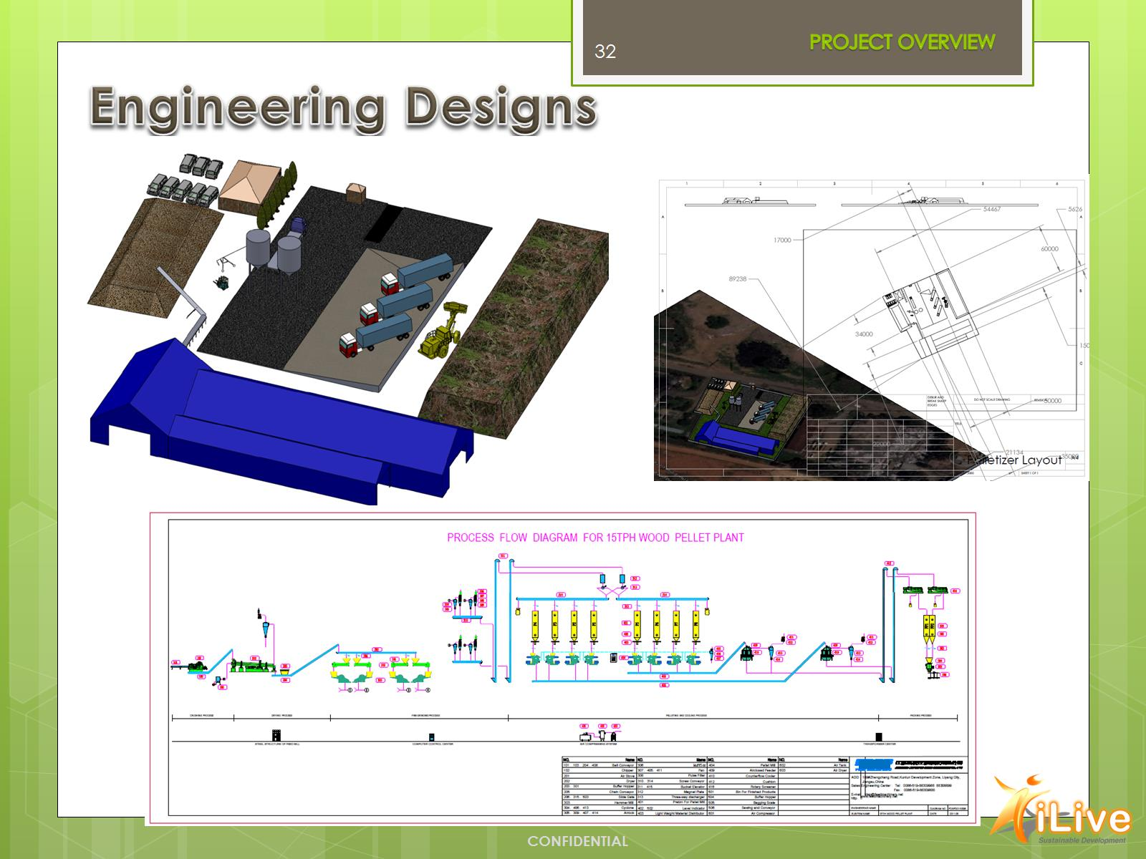
Engineering Designs

Slide 33
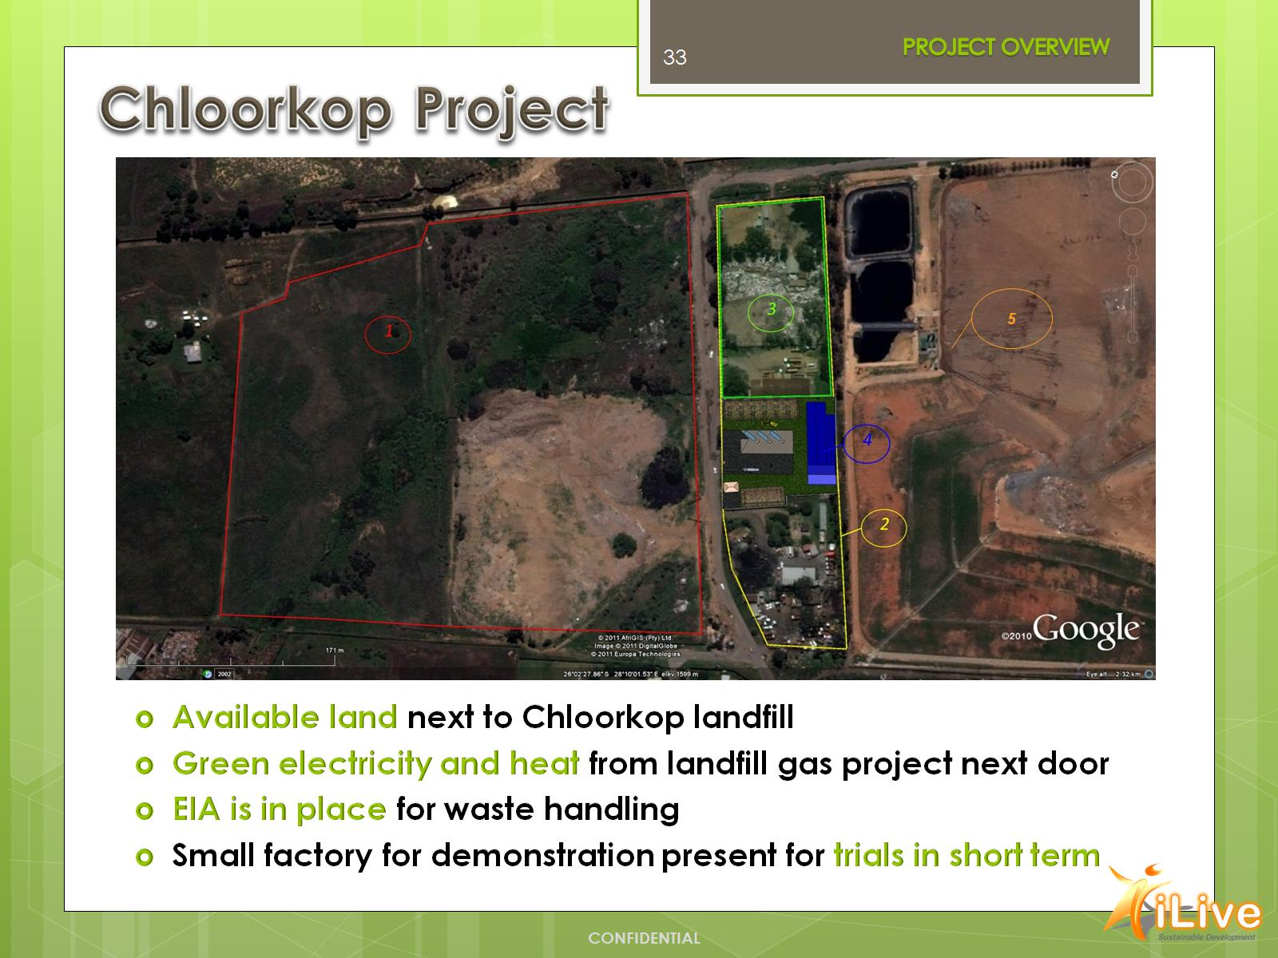
Chloorkop Project

Slide 34
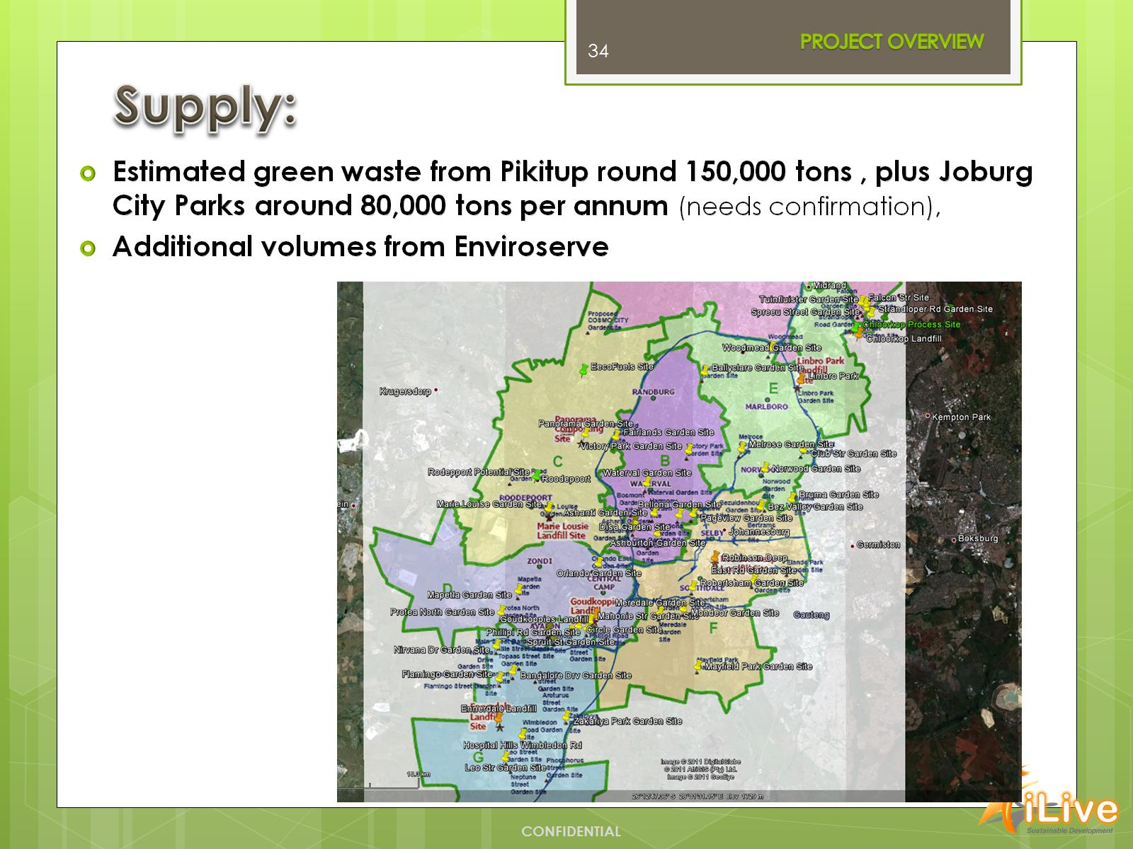
Supply:

Slide 35
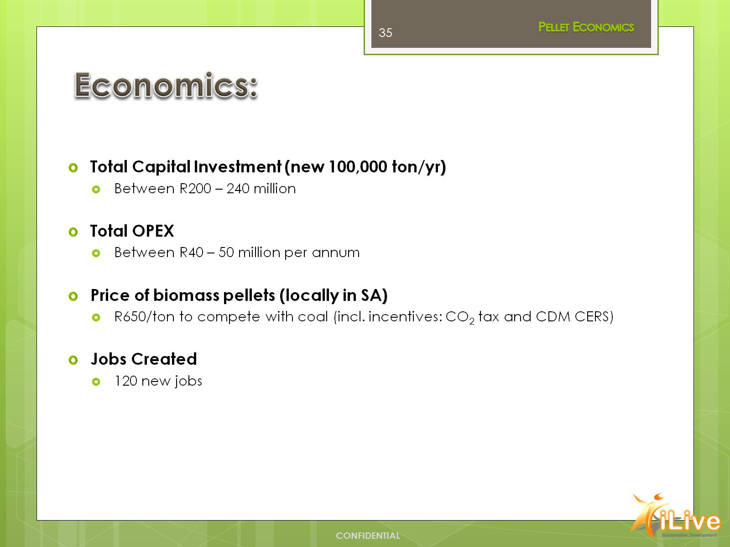
Economics:

Slide 36
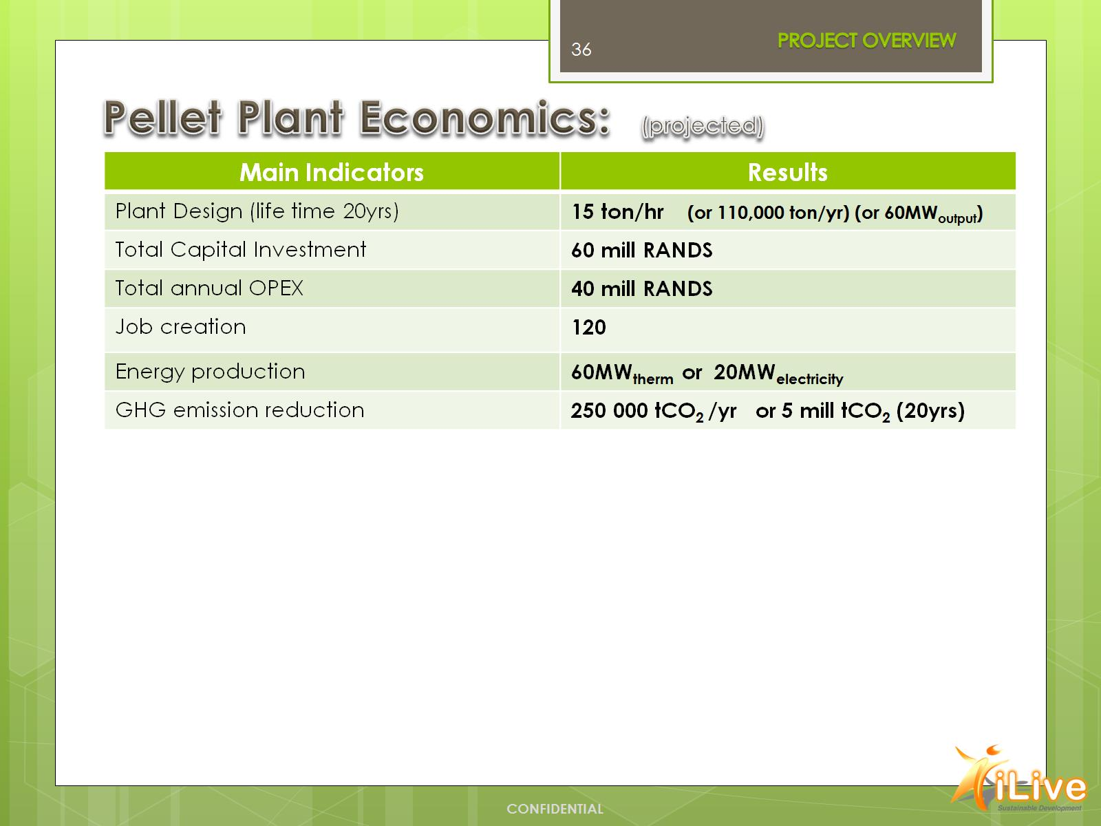
Pellet Plant Economics: (projected)

Slide 37
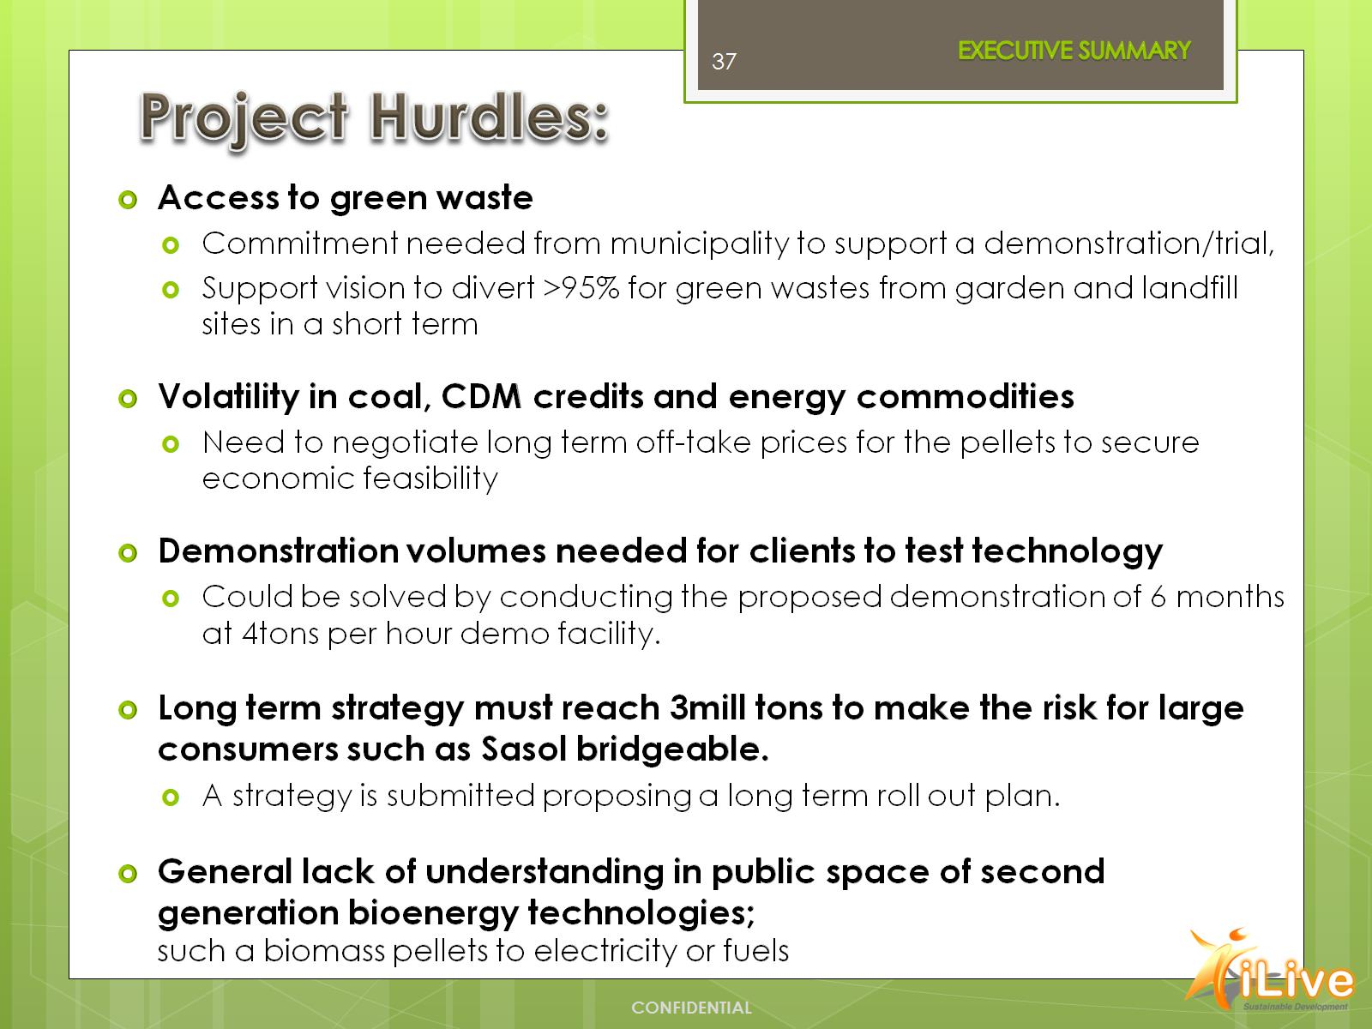
Project Hurdles:

Slide 38
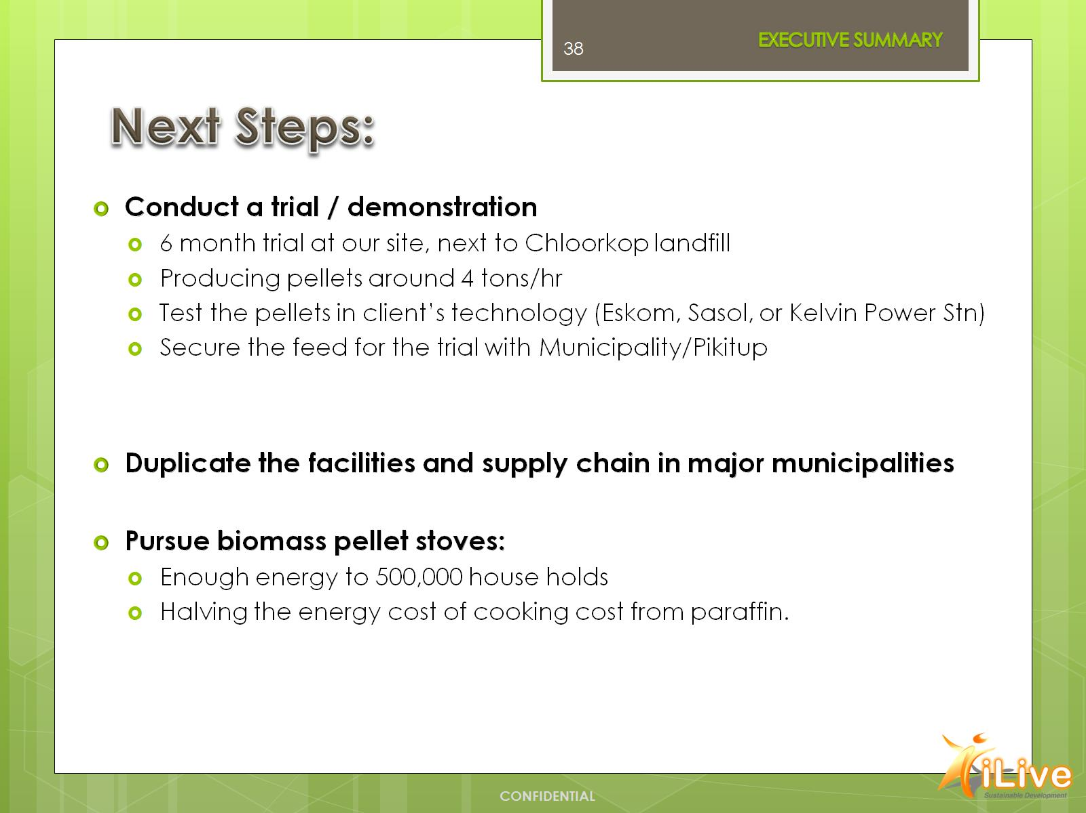
Next Steps:

Slide 39
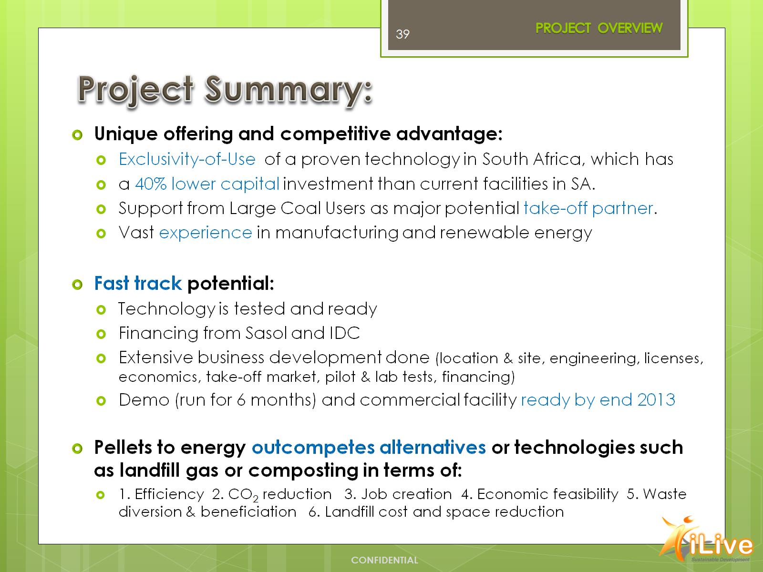
Project Summary:

Slide 40

Summary of Opportunity:

Slide 41
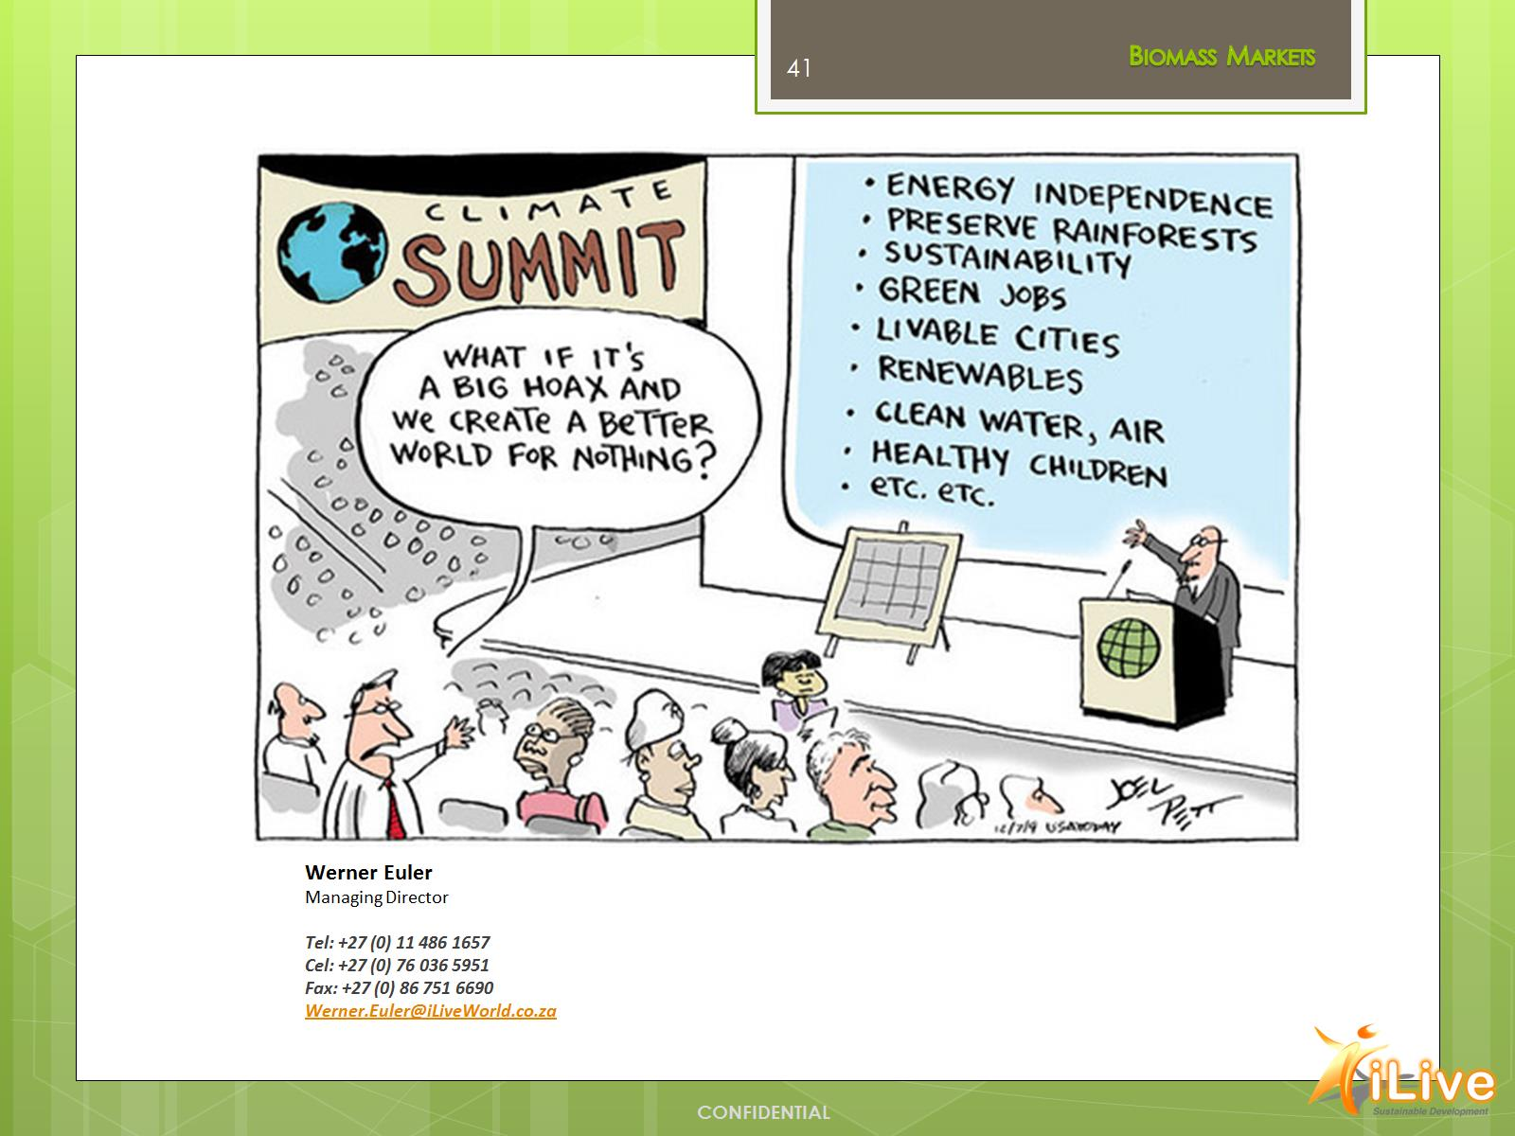

Slide 42


